Slide 1
Developed by IDP Group

Slide 2
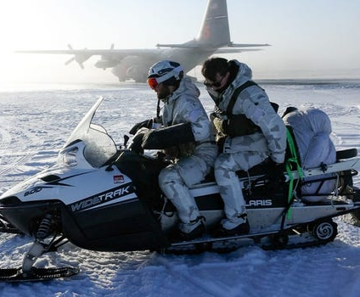
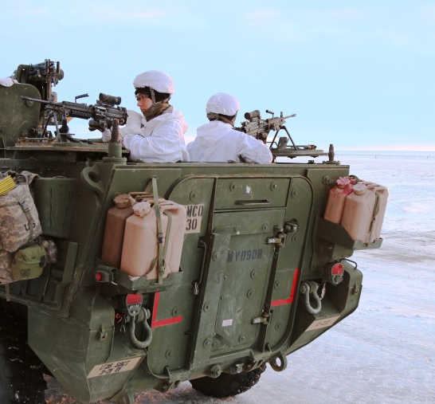
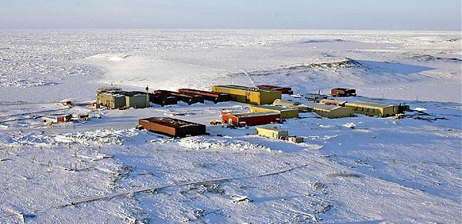
RETHINK THE BOX
“Benefits outweighed any shortfalls created by the need to build the infrastructure for the training exercise in the remote north”
Maj. Gen. Brian Eifler, commander of U.S. Army Alaska
“We’re trying to get to a place where we have Arctic capable forces — forces that can survive and operate in that environment," Army Secretary Christine Wormuth
Notes:
Designing & building civilian & military super resilient infrastructure for 2.5 years with a special focus

Slide 3
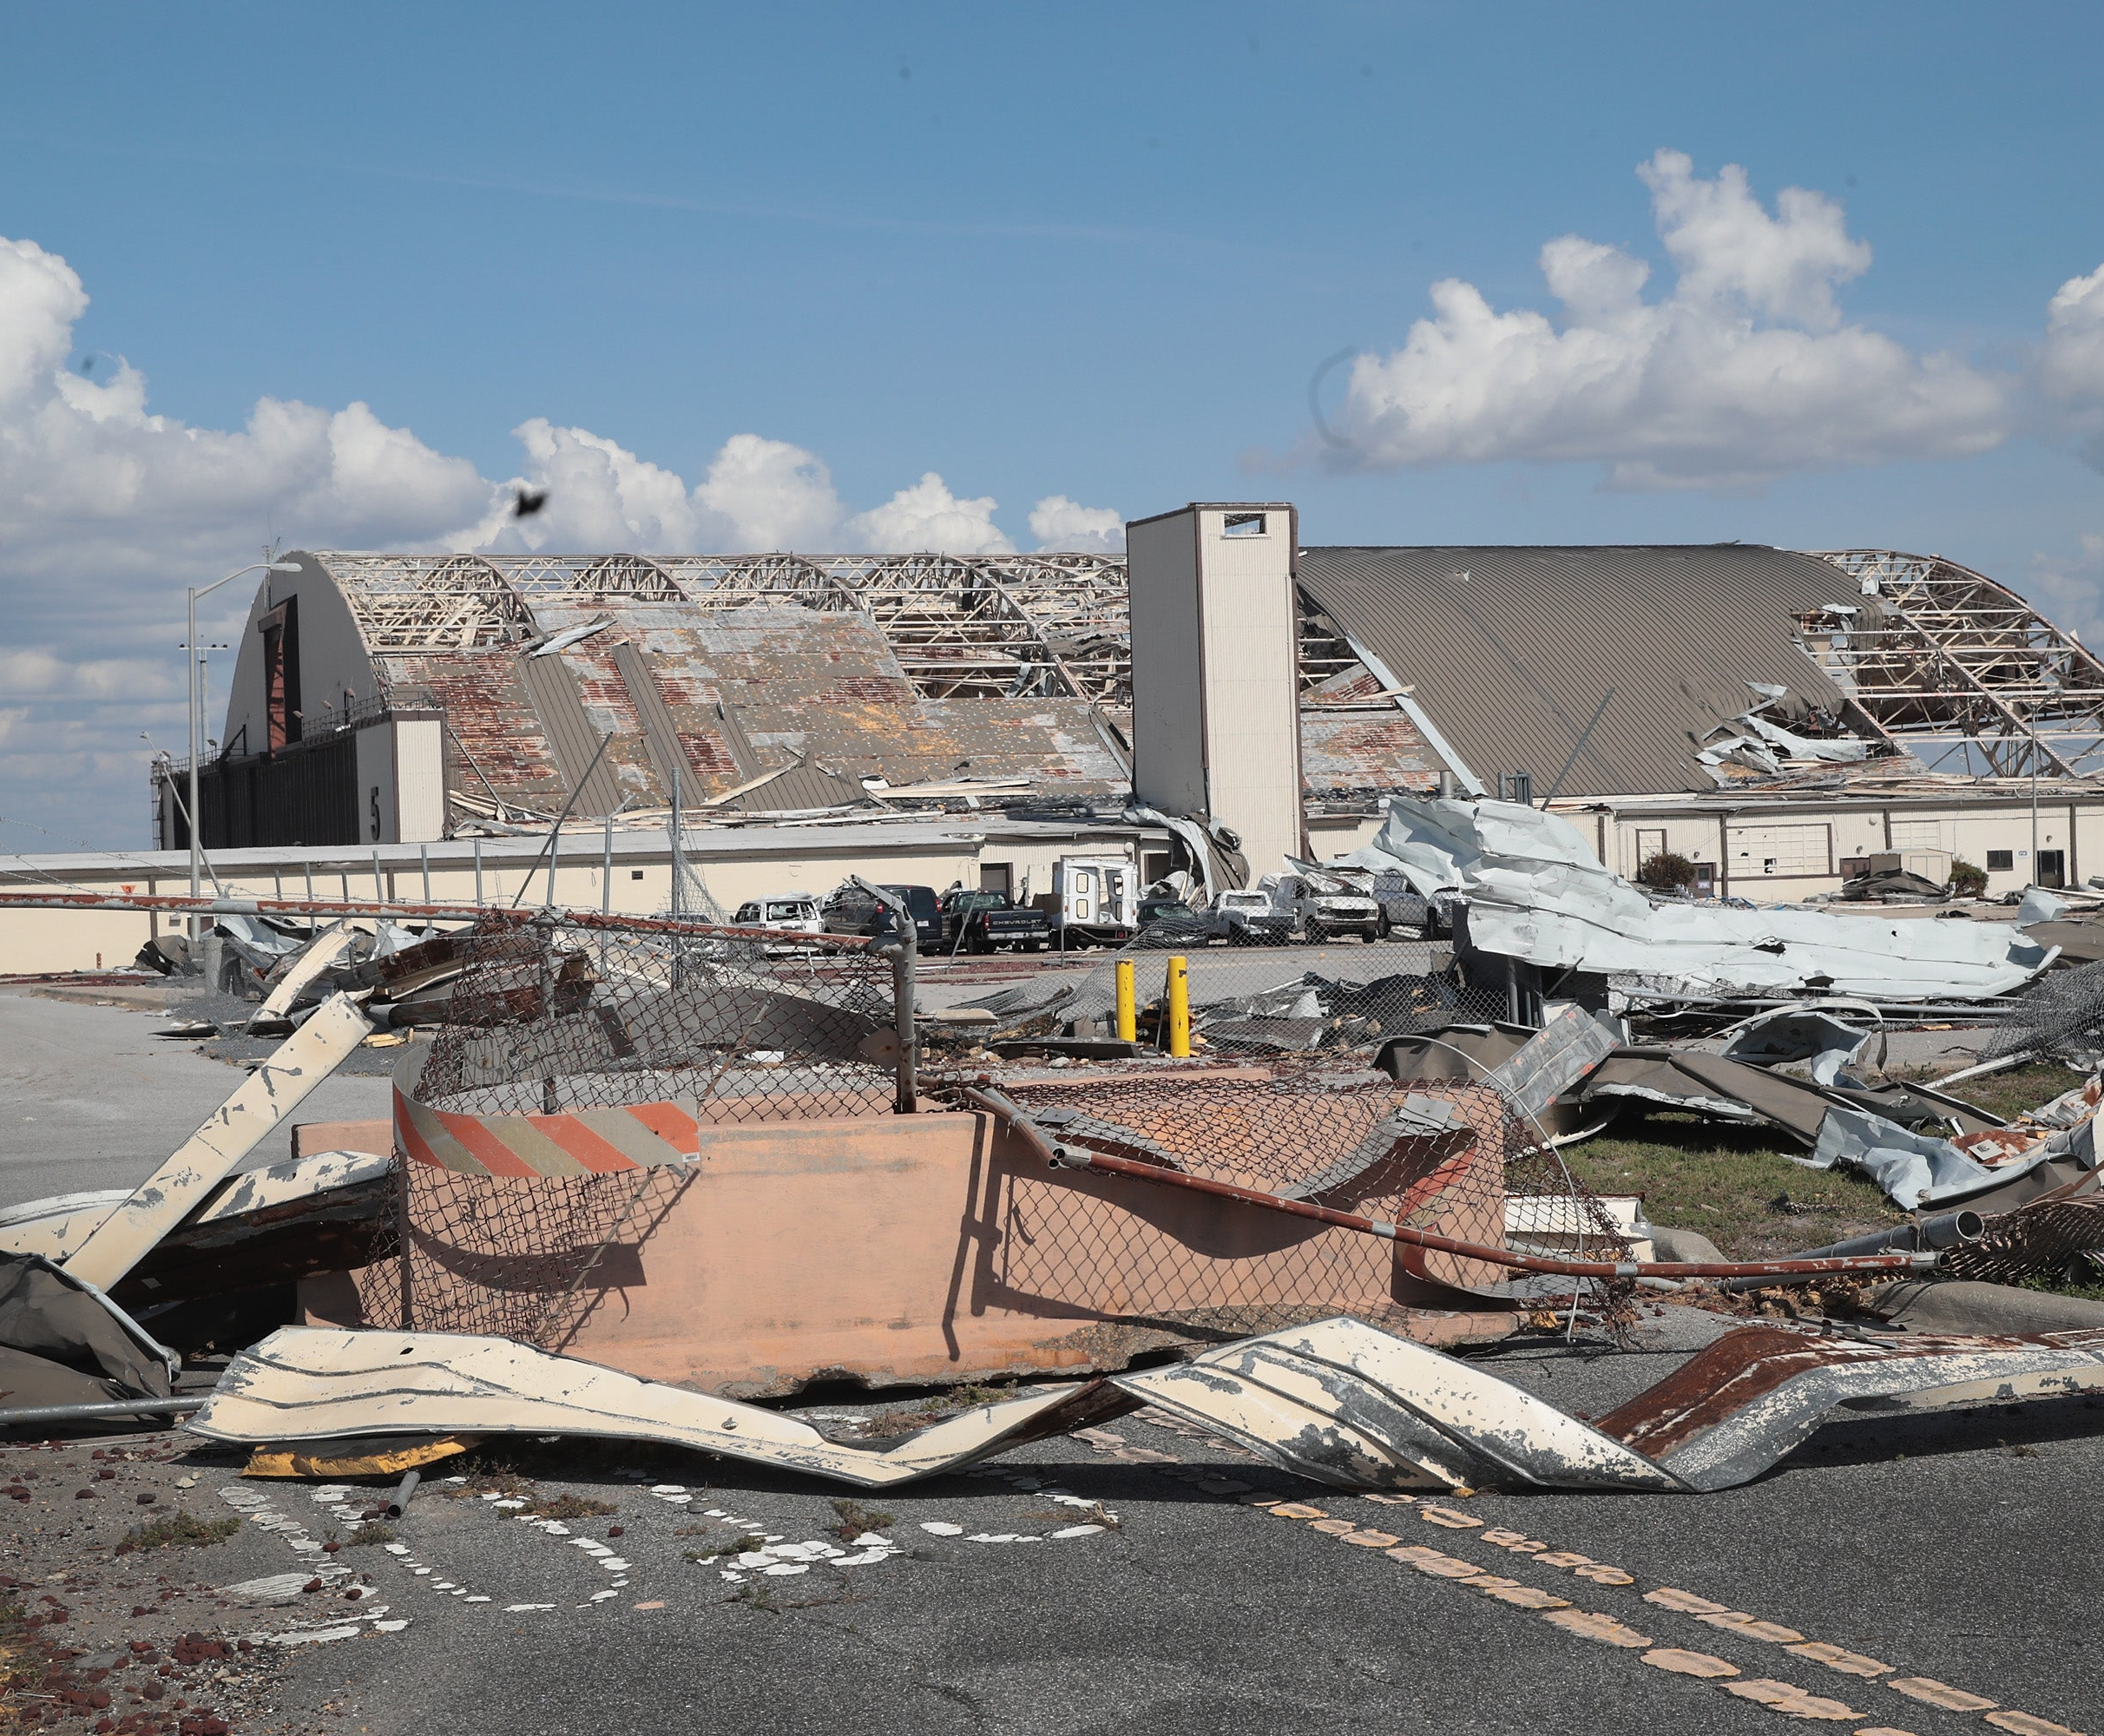
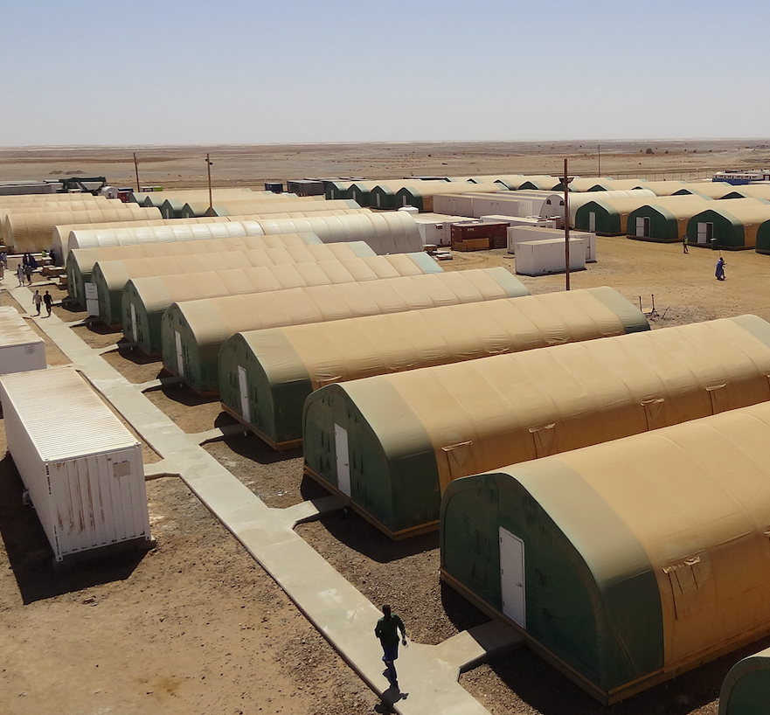
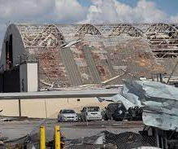
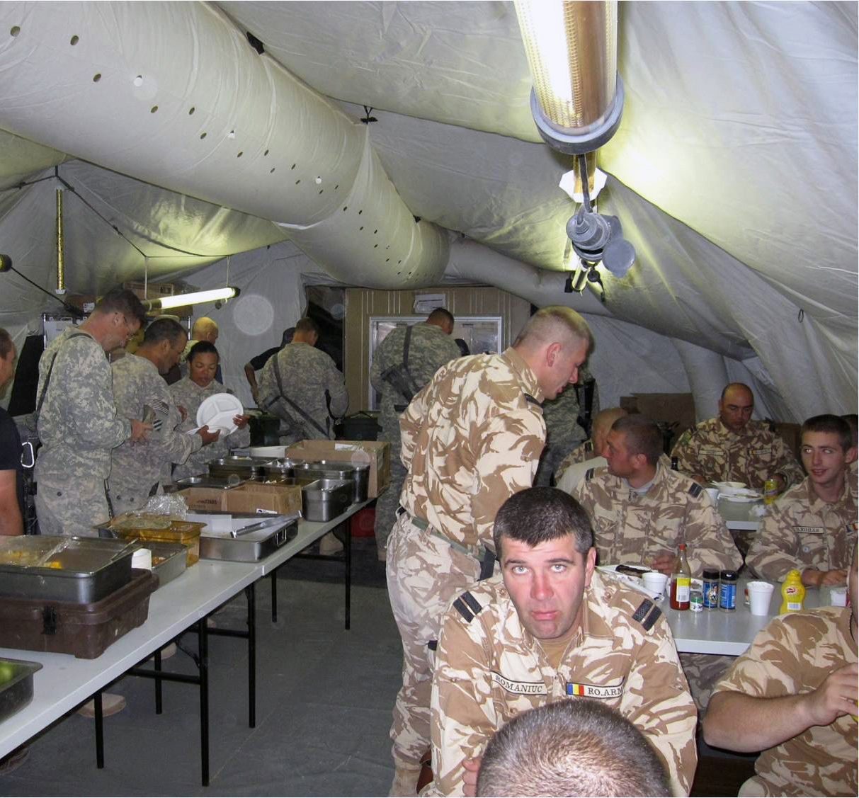
The Current Standard Of Structures With Rapid Deployment Capability
Designed for rapid deployment & temporary operations
Not designed/built to meet building code
Soft-shell solutions with few wood and light steel options
Inefficient post-build integration of electrical/mechanical/radar/comms systems
Minor resilience; limited seismic/storm resistance
Limited security for equipment/personnel
Limited solar panel and clean energy integration
Limited fire/life safety
No foundation system. Requires flat ground for deployment
Challenging when used as long-term heated facility in arctic
Offers little to no amenities to occupants
Low building insulation/R rating
Notes:
Great for some use cases, but not all use cases
Was not designed for long term use, although it tends to stay in places for ever

Slide 4
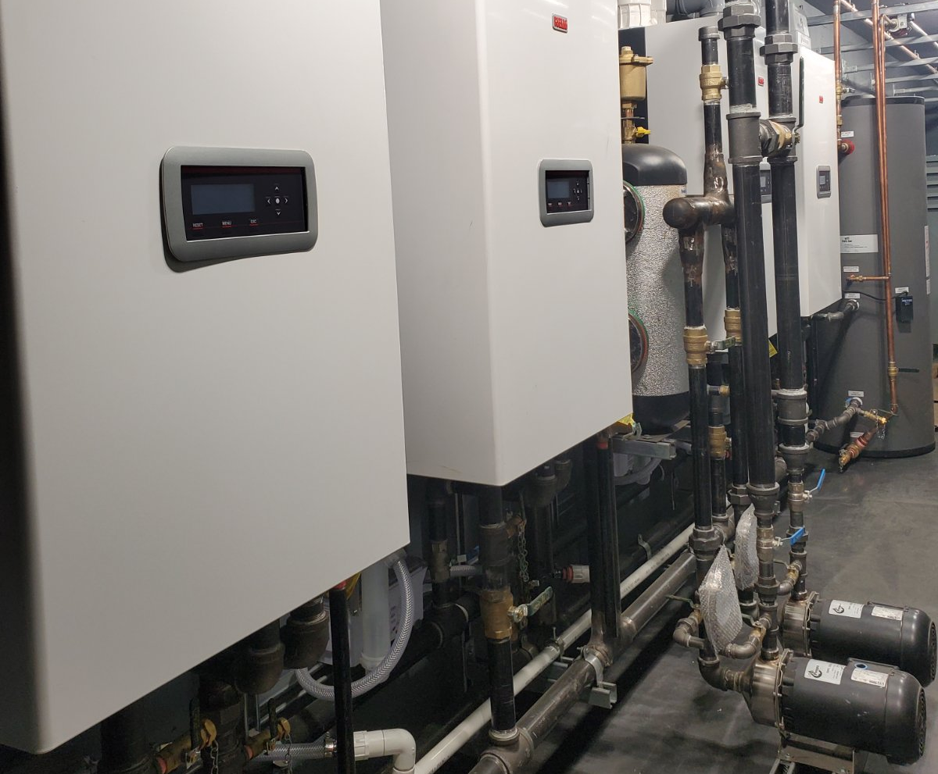
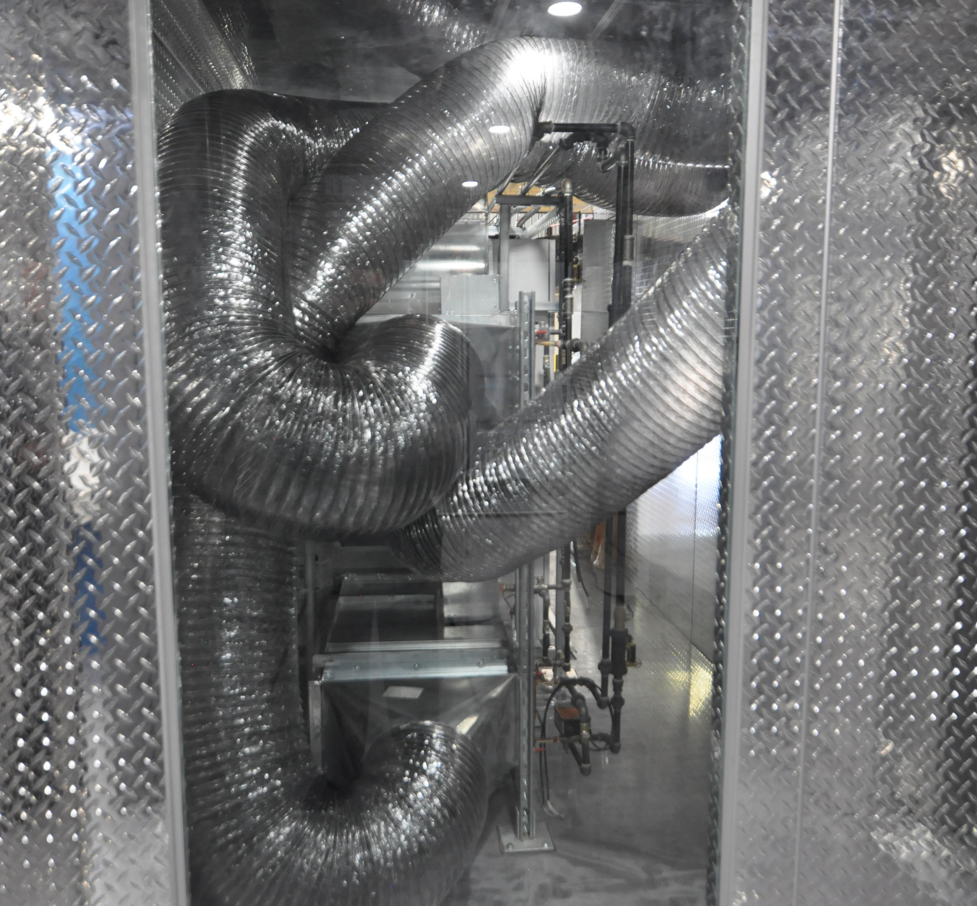
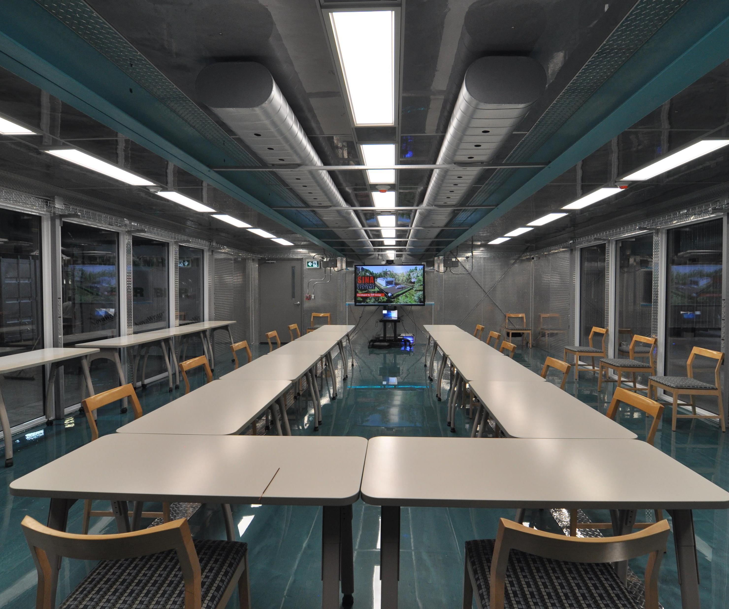
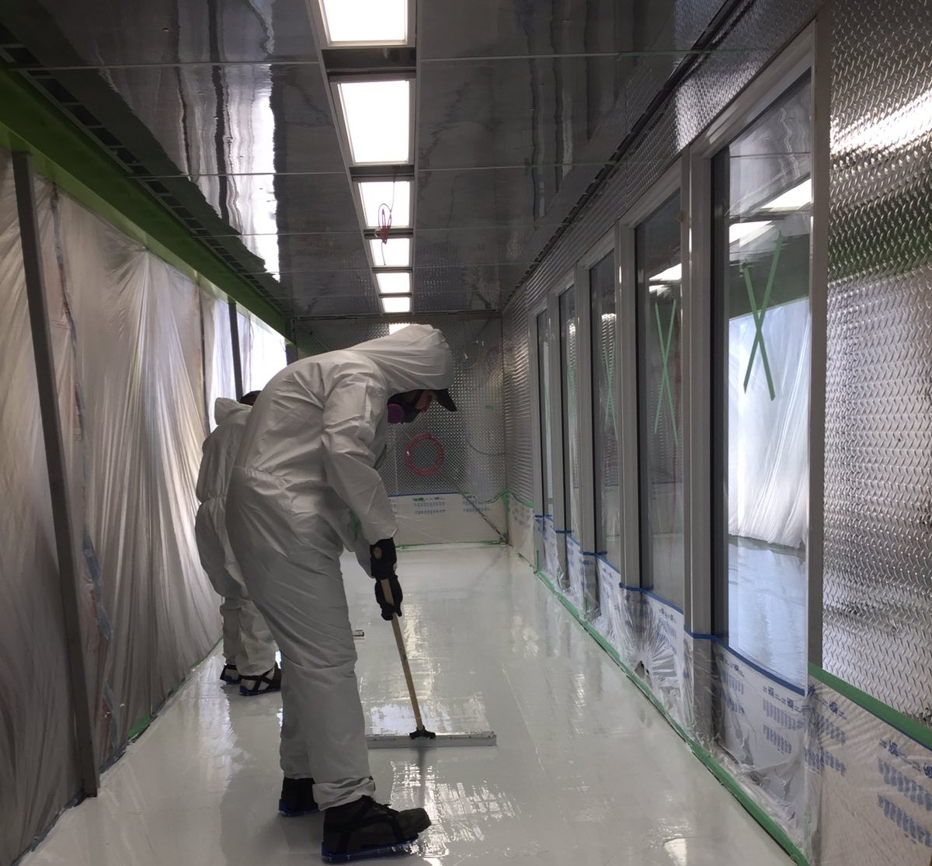
Core Benefits of SINA Building Systems
Designed for medium/long term deployment
Complex components (HVAC, radar, comms, IT) installed and tested at factory
Built to Canadian National Building Code
Factory controlled manufacturing process
Positive/Negative pressure HVAC with HEPA filtration
Up to 50% reduction in-factory construction time when compared to similar structures
Up to 30% reduction in construction cost for similar structures
Entire structure relocated or adjusted in event of fire/flood/emergency
Fire resistant with built-in fire suppression
Build a 10,000 sqft NBC Compliant facility in 4wks from grass to finish. Deployed by crew of 20
Modular and scalable (300 to 50,000 sqft)
Proprietary electrical/mechanical/structural quick connects
Multi-level structures up to 30’ft tall
NBCD, Ballistic, Blast and frag resistance
Notes:
Our surroundings directly effect our quality of life, work and mental state
We bring urban level design, functionality & finishes to remote areas in a rapidly deployable solution
Inspections done at our facility
95% less site time
Easy to clean & disinfect surfaces

Slide 5
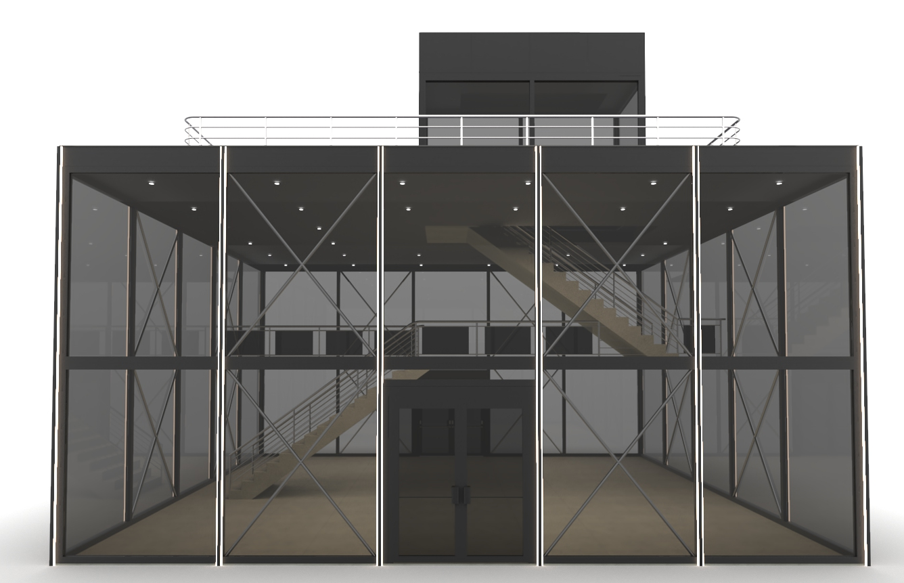
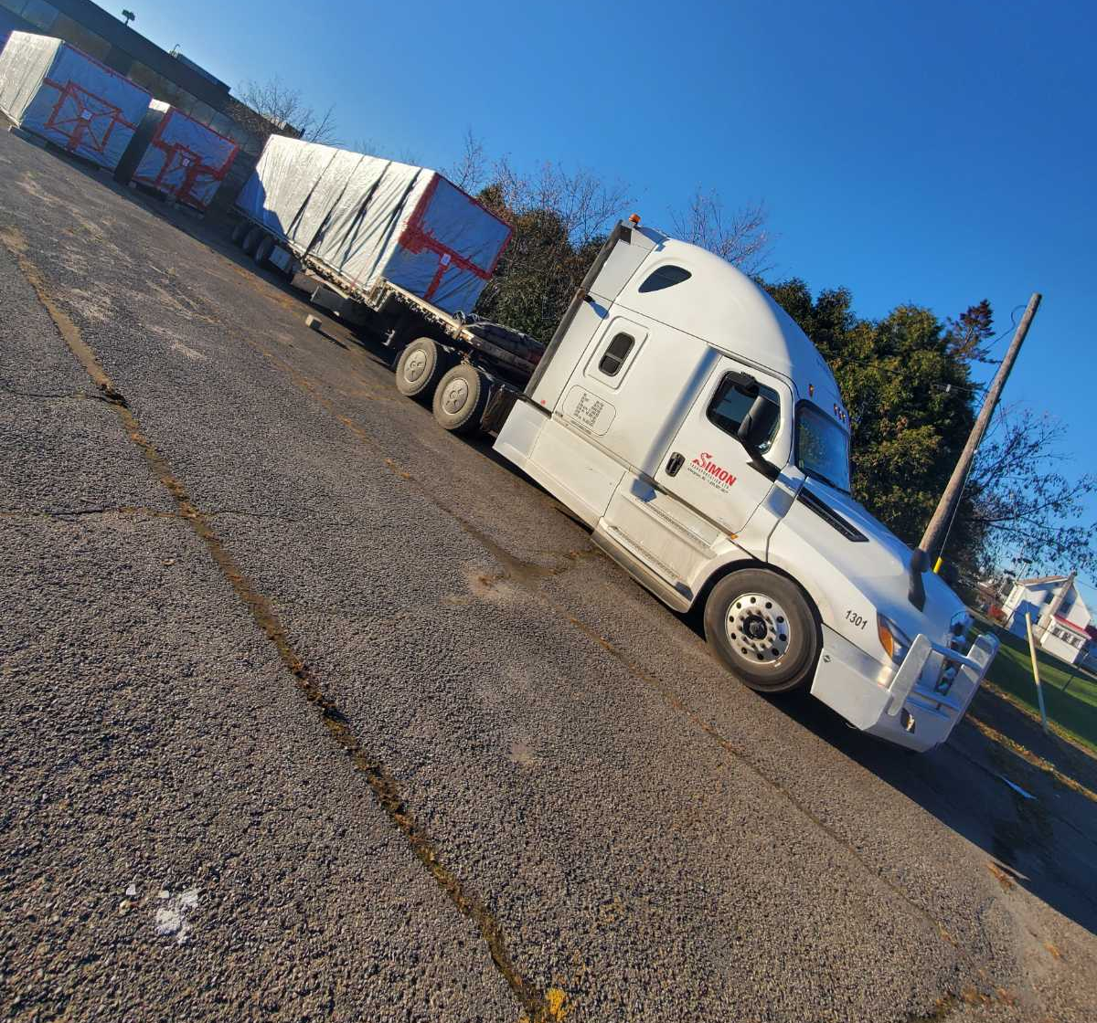
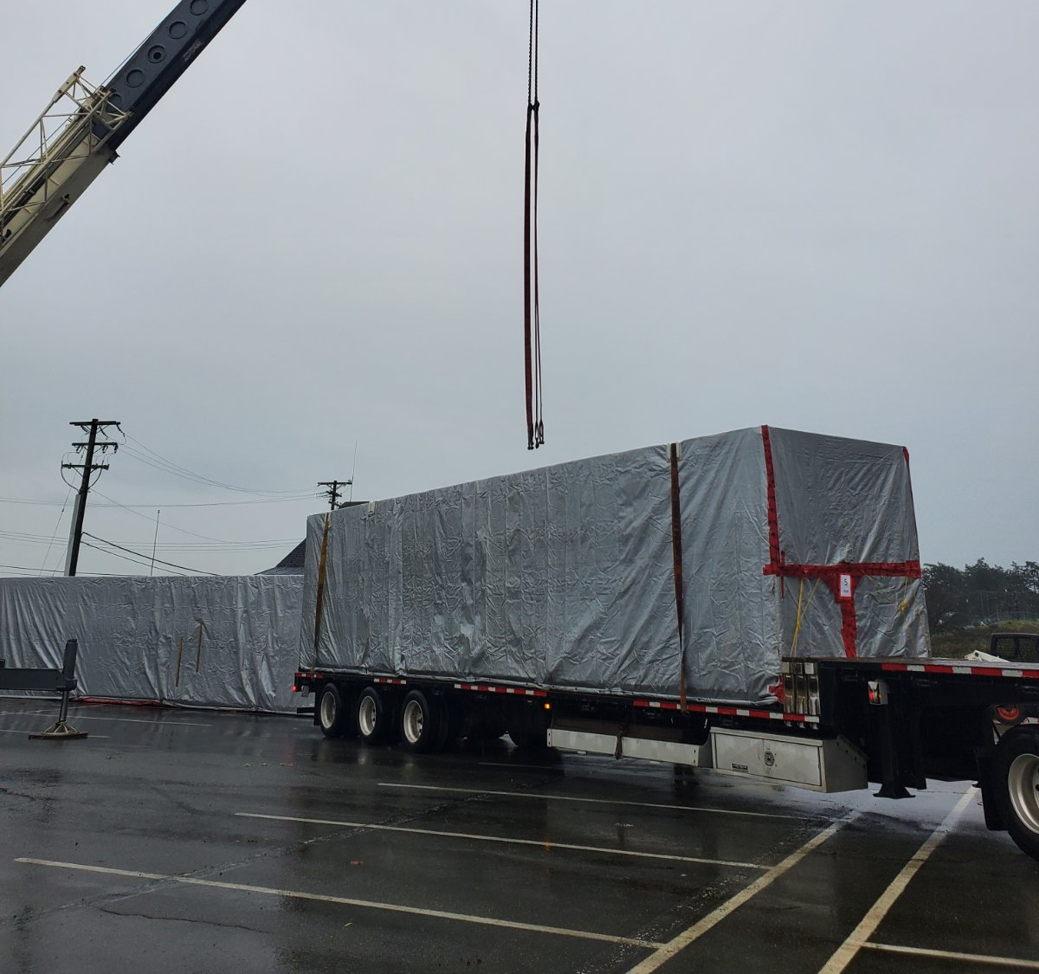
SINA Building Systems Exclusives
Volumetric & structural wall plug & play galvanized heavy steel prefabricated modular building solution
Complete grass to finish building system
Adjustable, reusable, seismic-rated foundation system capable of deploying on permafrost
Structural walls with built-in finishes, windows, doors, fire suppression, networking & security components, lighting, insulation and electrical components pre-installed
Prefabricated building system with built-in green components, hard ridged roof mounted solar panels with batteries & invertors installed and packaged with quick connects
Notes:
Tall buildings ship flat packed with traditional transport, packaged ready for quick deployment
Spyder cranes can ship with the modules for erection

Slide 6
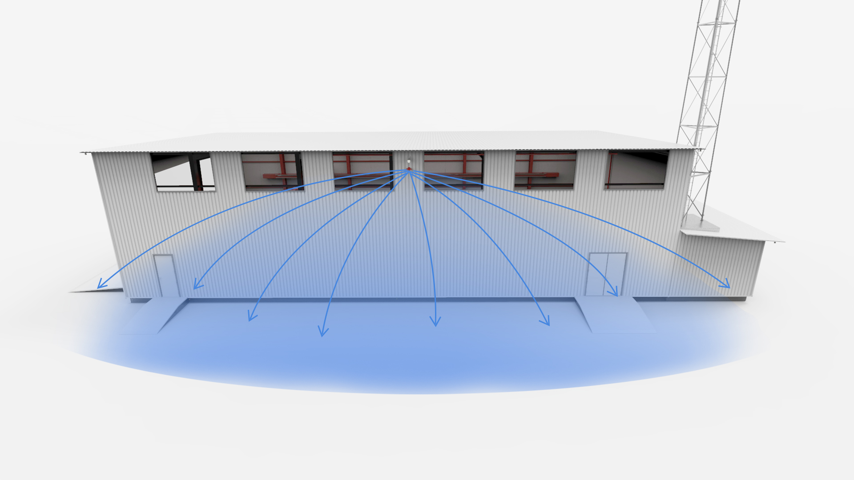
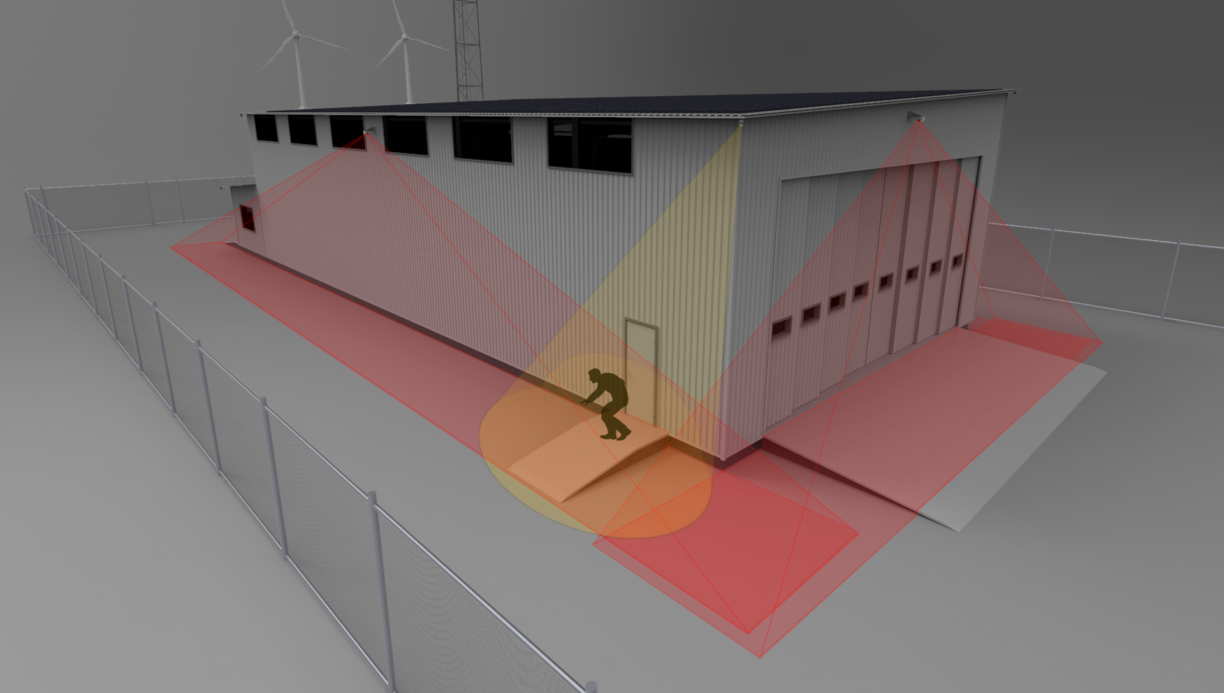
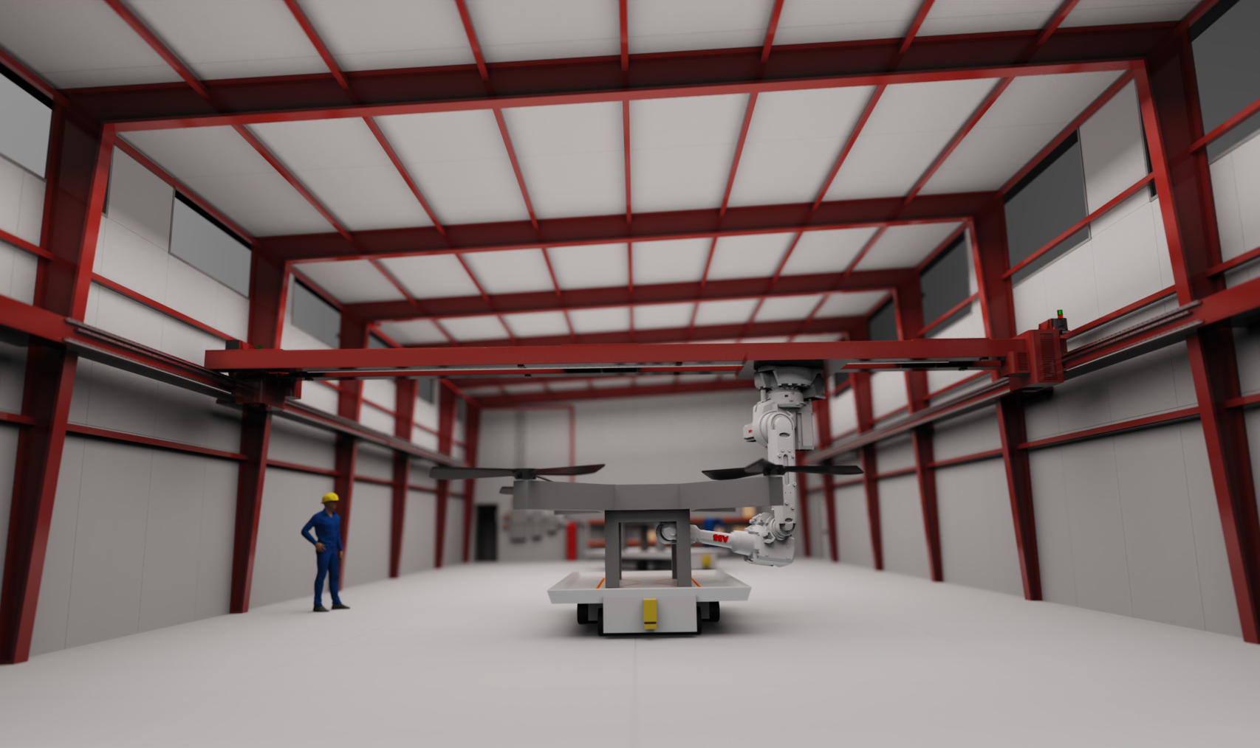
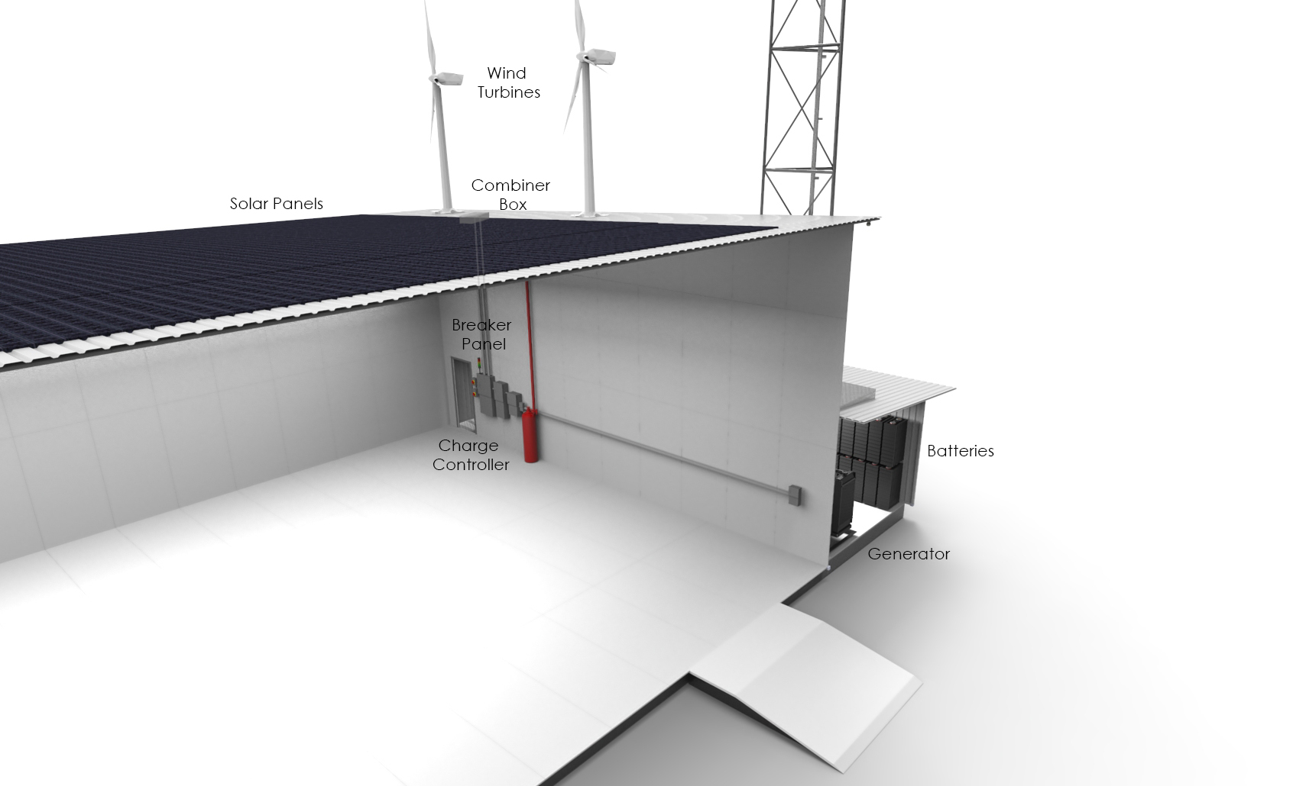
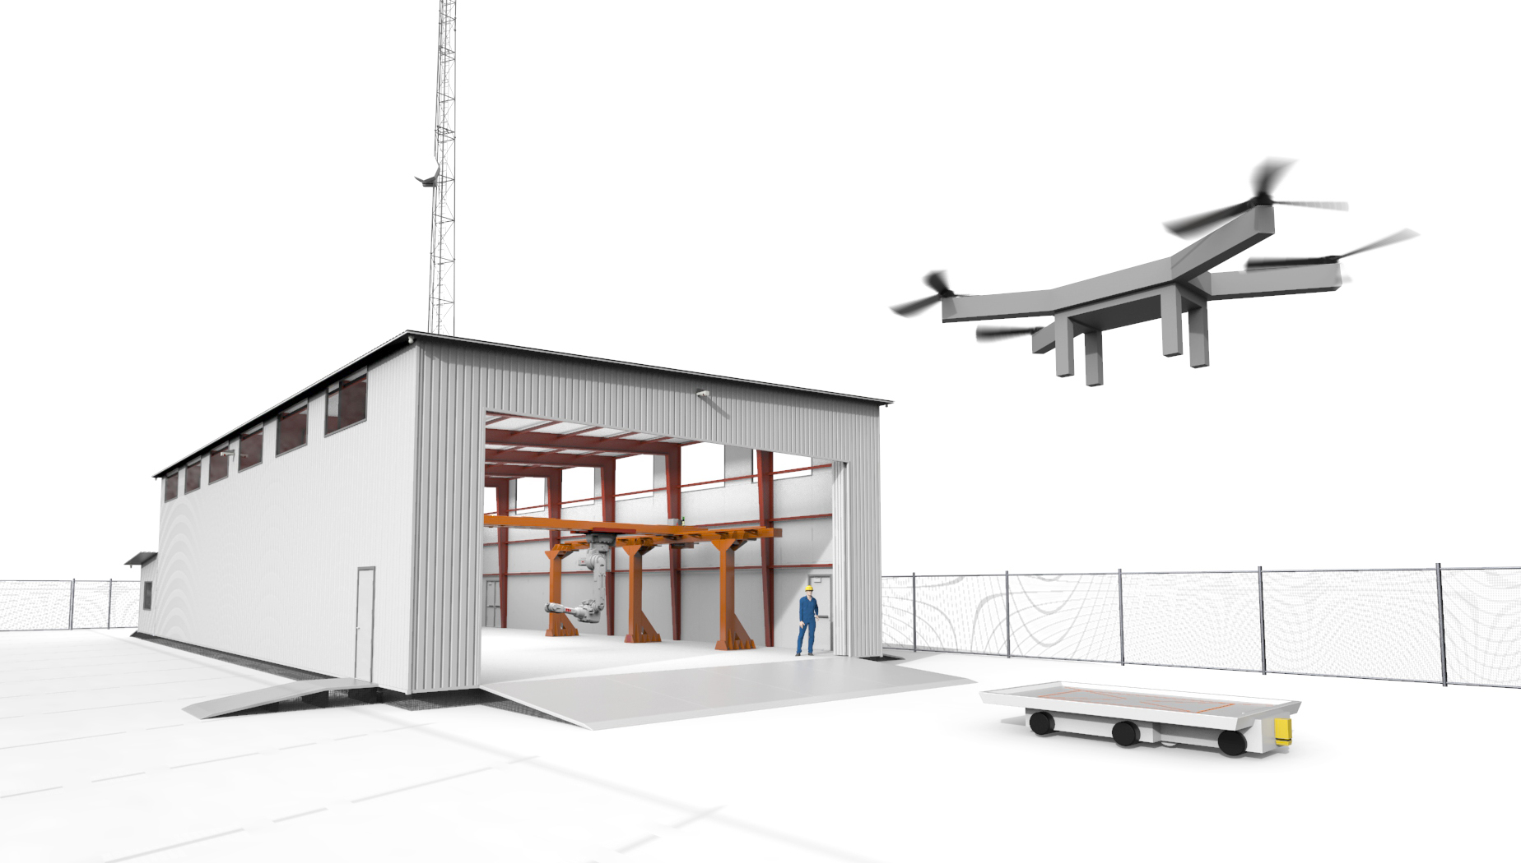
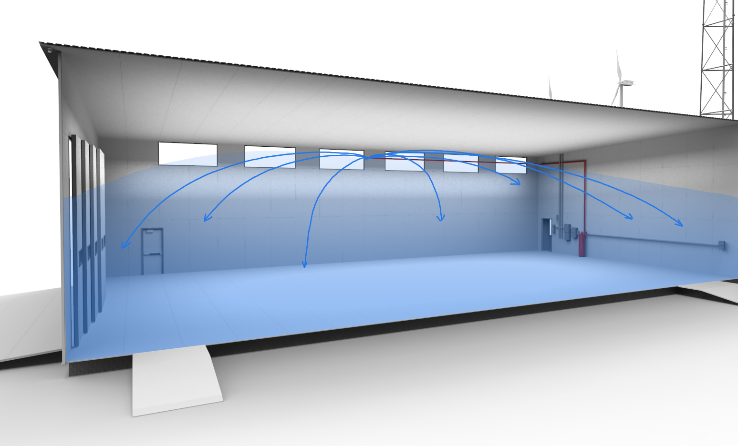
FOB Command Control & Communications Centre
Different sizes & configurations with variety of integrated tech solutions
Heavy raised flooring system allows operations of heated repair/garage on permafrost
Heavy steel gantry crane
Clean agent fire suppression system
Radar, cellular, broadband connectivity
Secure operations
Integrated clean energy components (solar / wind) with battery bank, back up generators with optional CHP
Notes:
Working with Air Canada Cargo, West jet cargo for roughly 18 months as well as multiple remote communities & commercial drone operators in Canada
Big focus on renewable & clean energy component

Slide 7
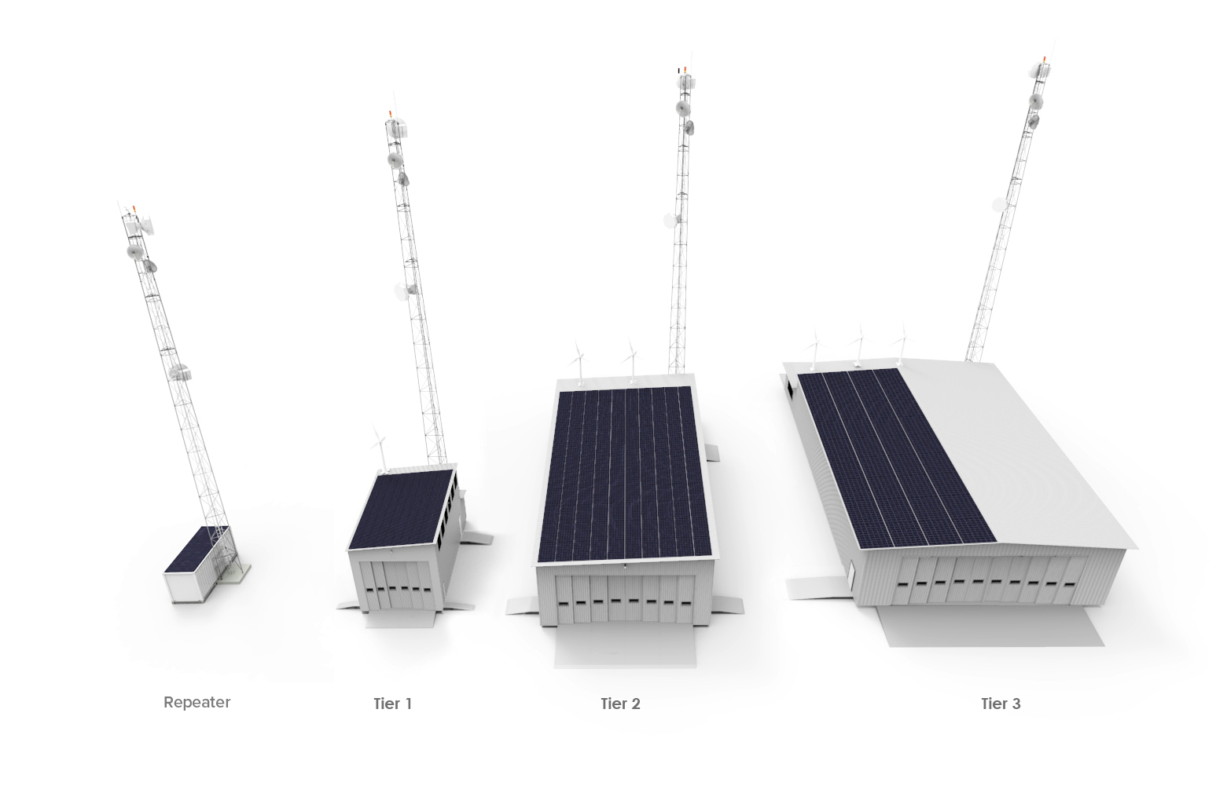
FOB Sizes Including Communication Repeater Station

Slide 8
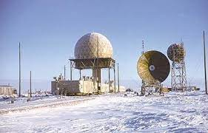
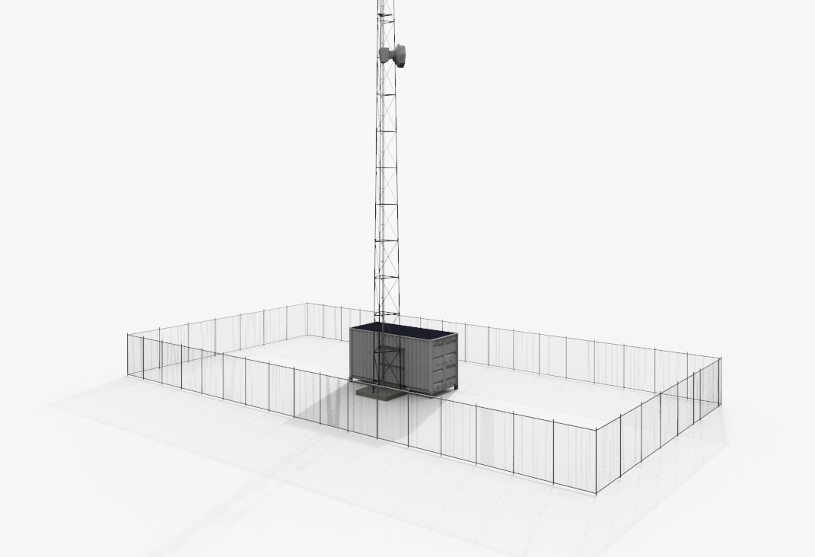
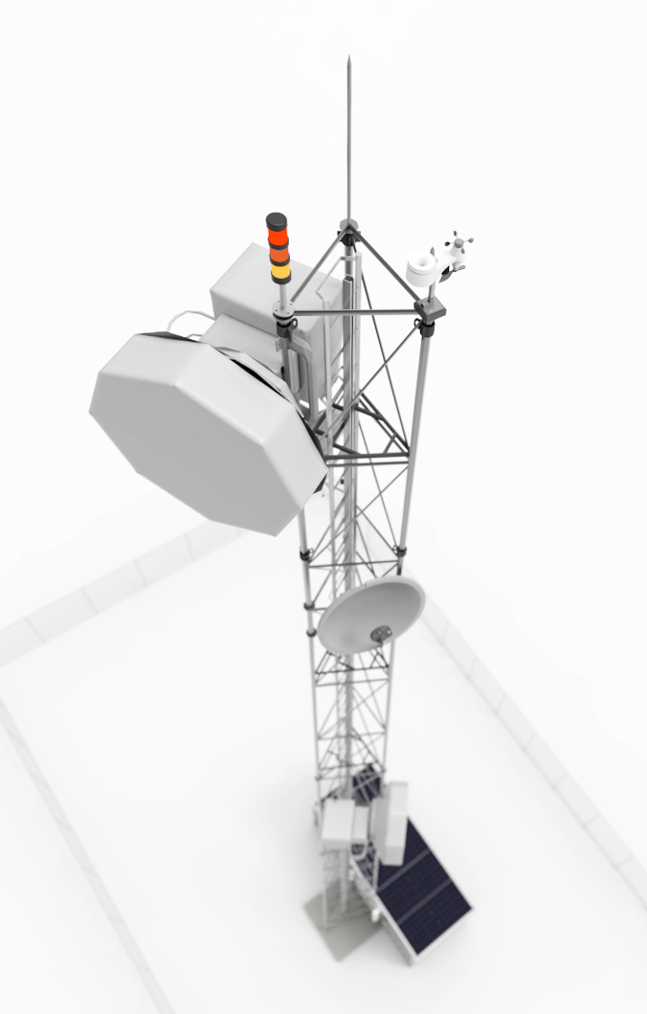
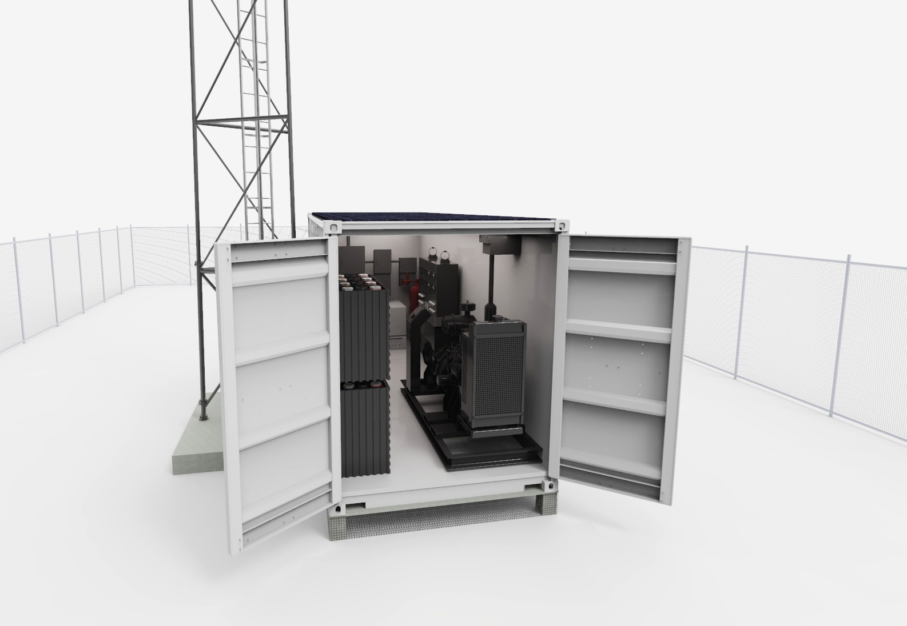
Communication Repeater Station
Providing data / cell / radar connectivity across the north
Self containing energy source with solar and wind
Battery & generator back up
Air lift ready
Expanded radar and communications
Notes:
Small foot print with air deployment capability

Slide 9
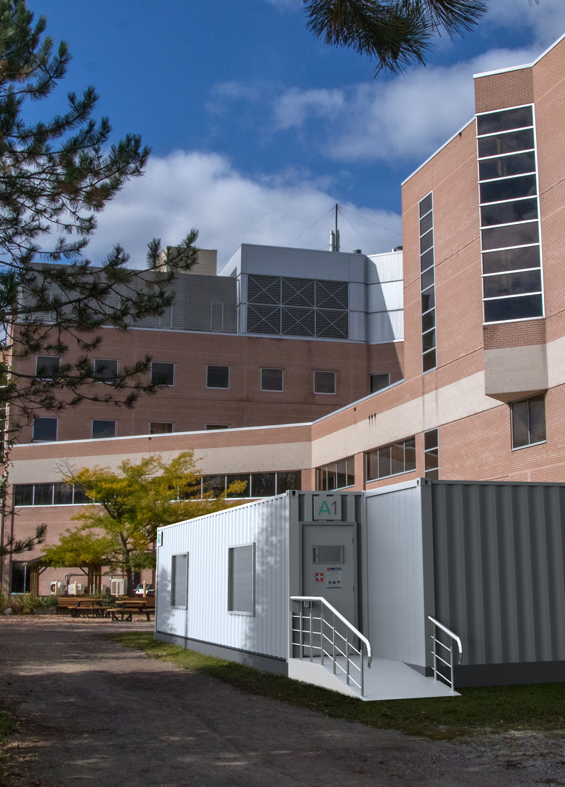
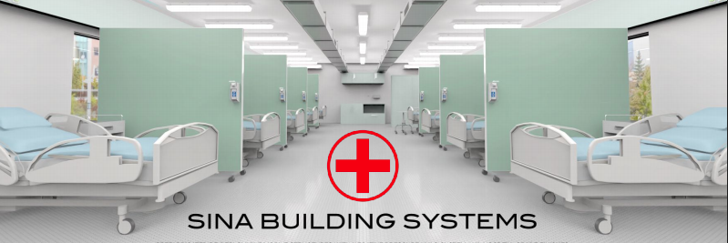
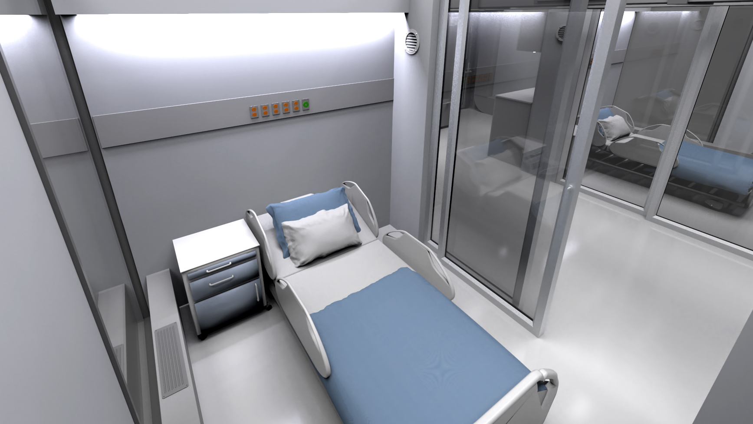
Medical Facility
Portable scalable self-sufficient, Rapidly deployable Pandemic resilient HealthCare & Institutional Solutions with negative pressure HVAC, health care grade electrical & finishes & medical gas distribution
Notes:
From general care to ICU level

Slide 10
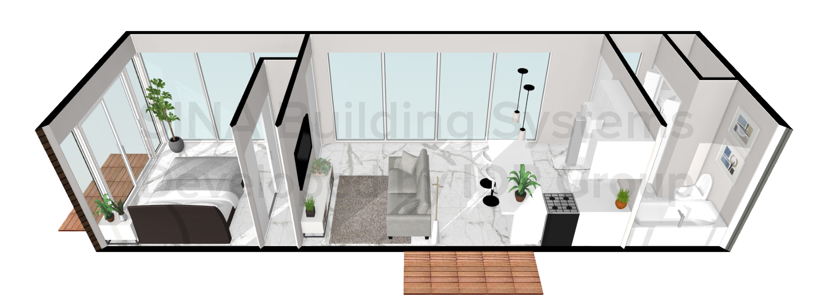
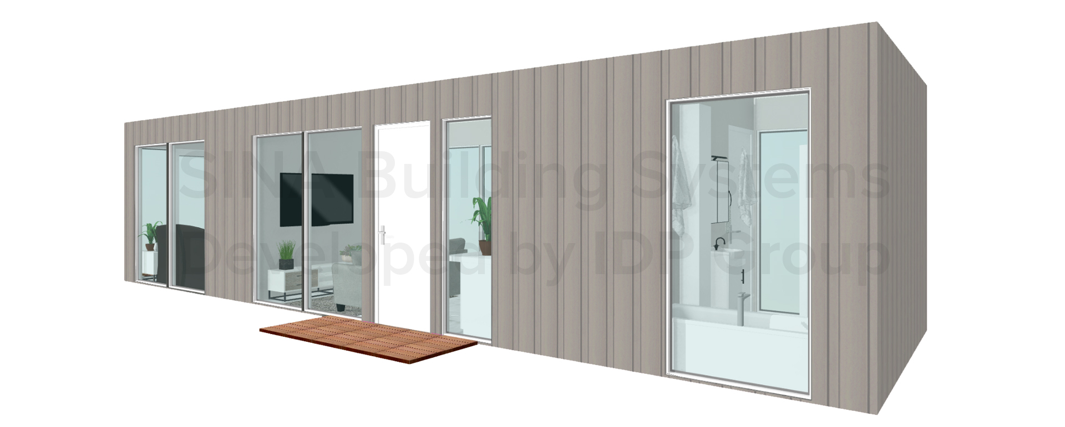
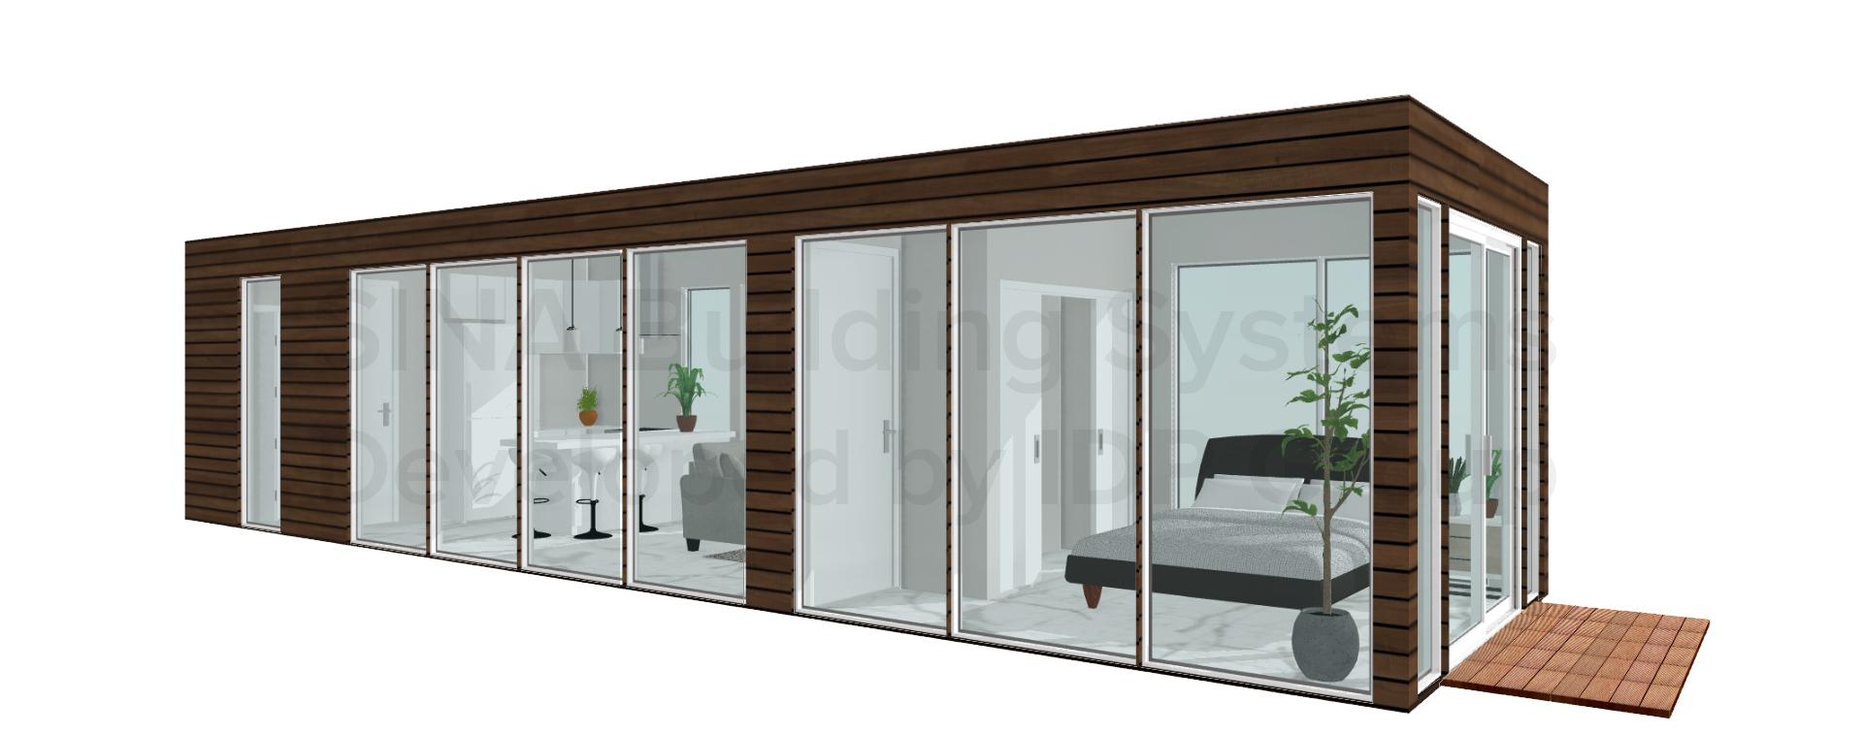
Accommodations (shipping complete with furniture & appliances)
Fully Prefabricated Steel Frame Accommodation Units for remote Canadian areas. Heavy steel modules are stackable and can create multiplex developments for short & long term accommodations
1 Bedroom including SINA Foundation & Appliances & 150 SQFT rooftop deck
Starting at $195,000*
Notes:
Stackable for to 3 levels (can go higher, need elevator)

Slide 11
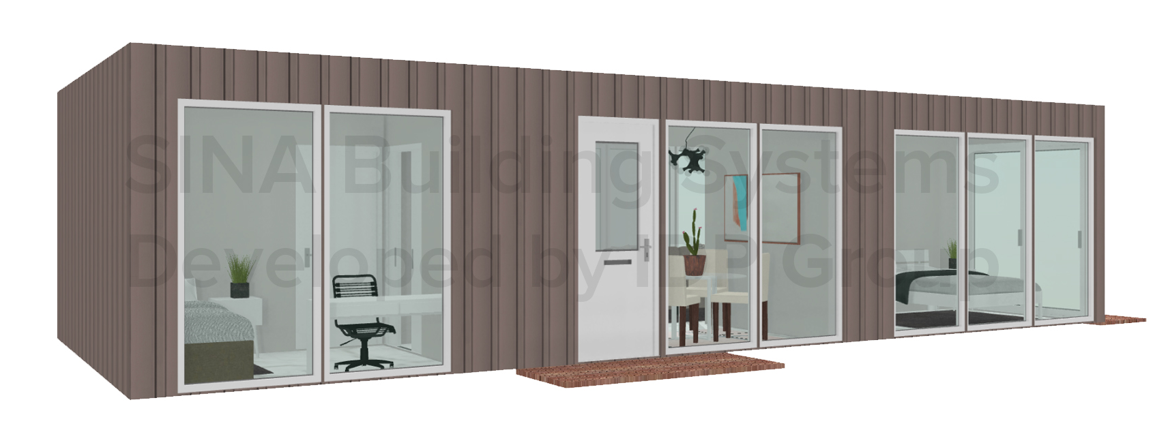
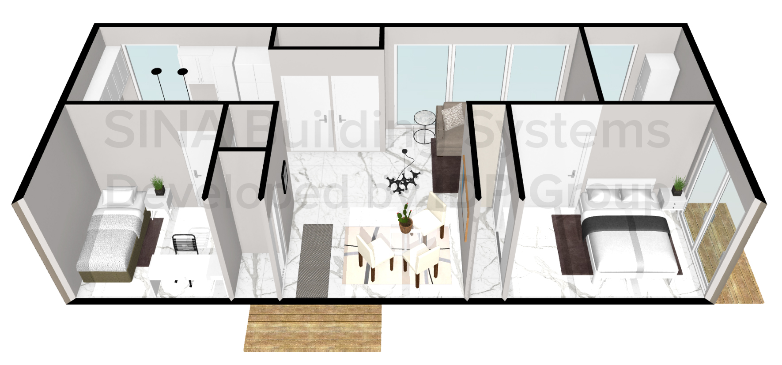
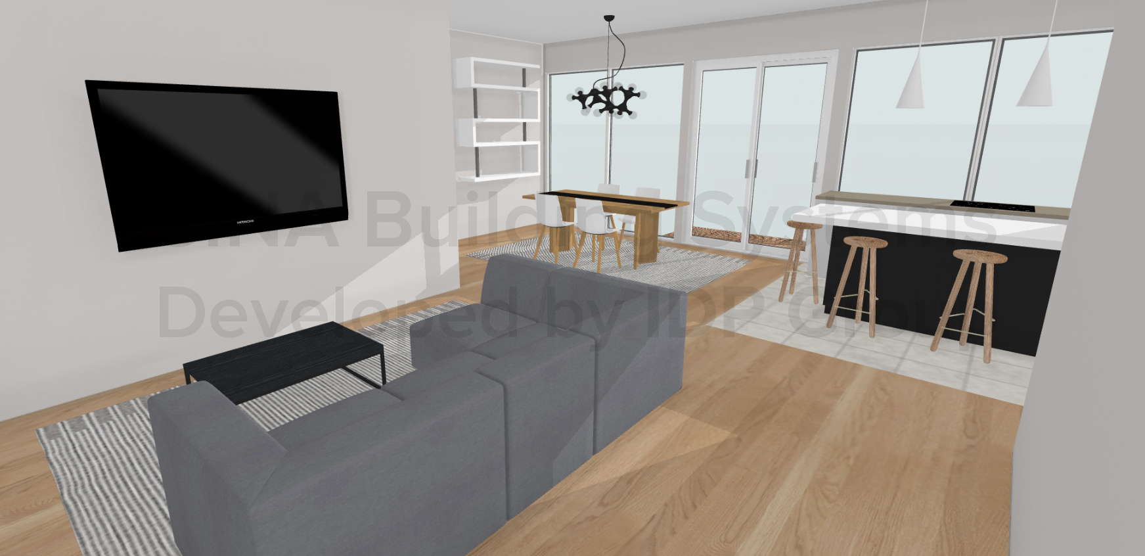
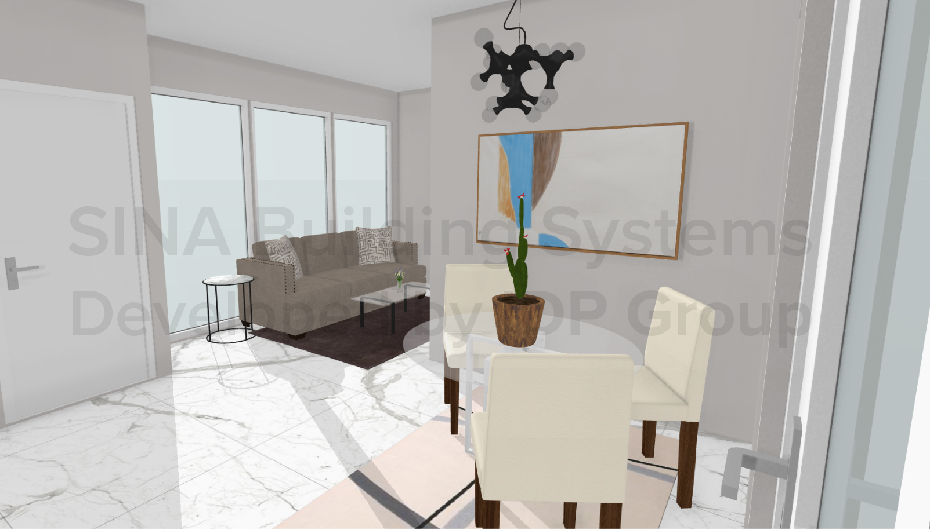
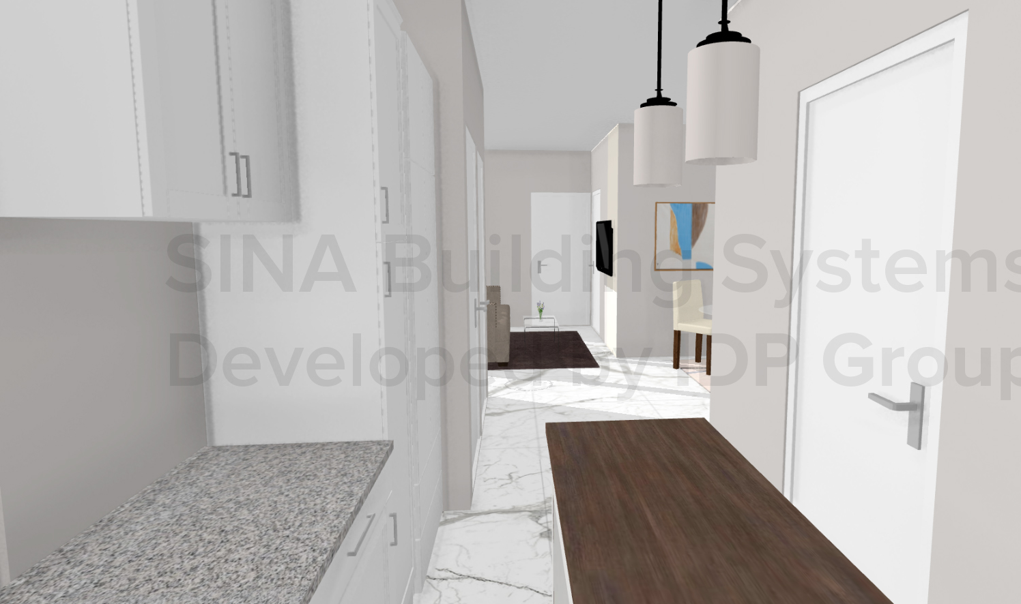
Accommodations (shipping complete with furniture & appliances)
2 Bedroom including units starting $300,000

Slide 12
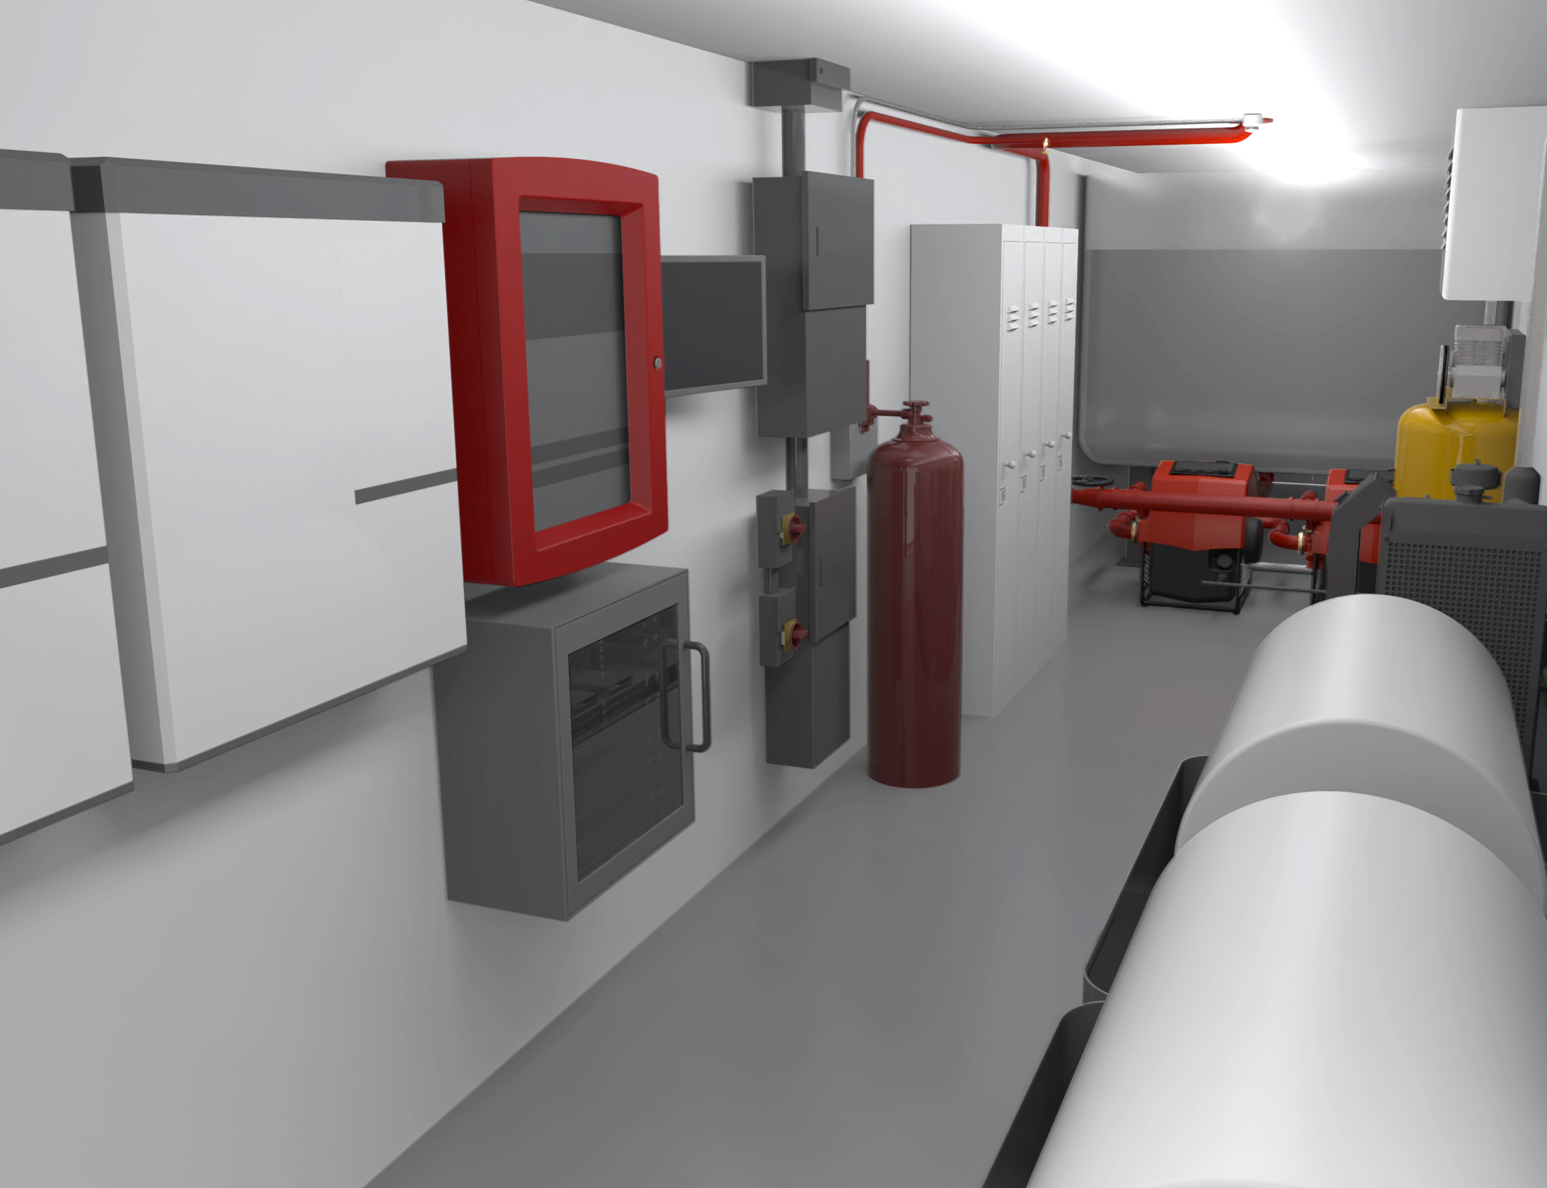
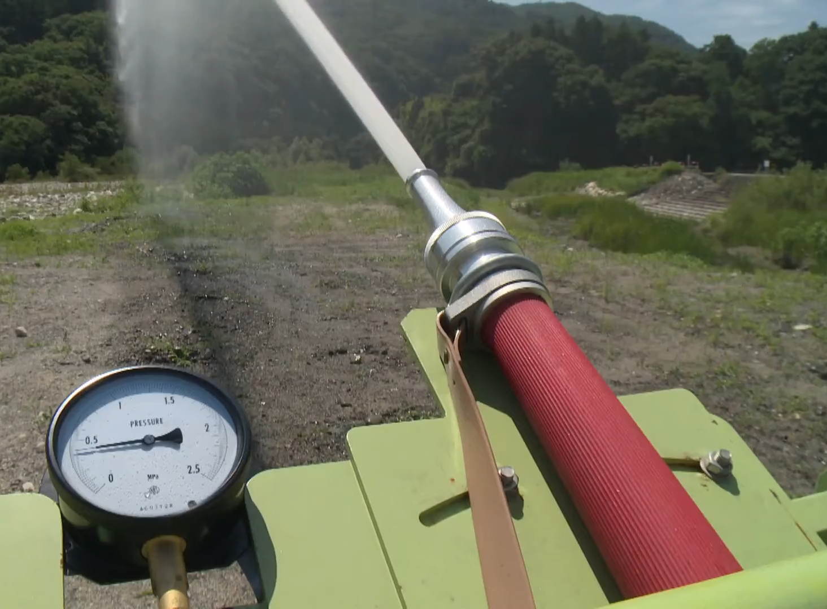
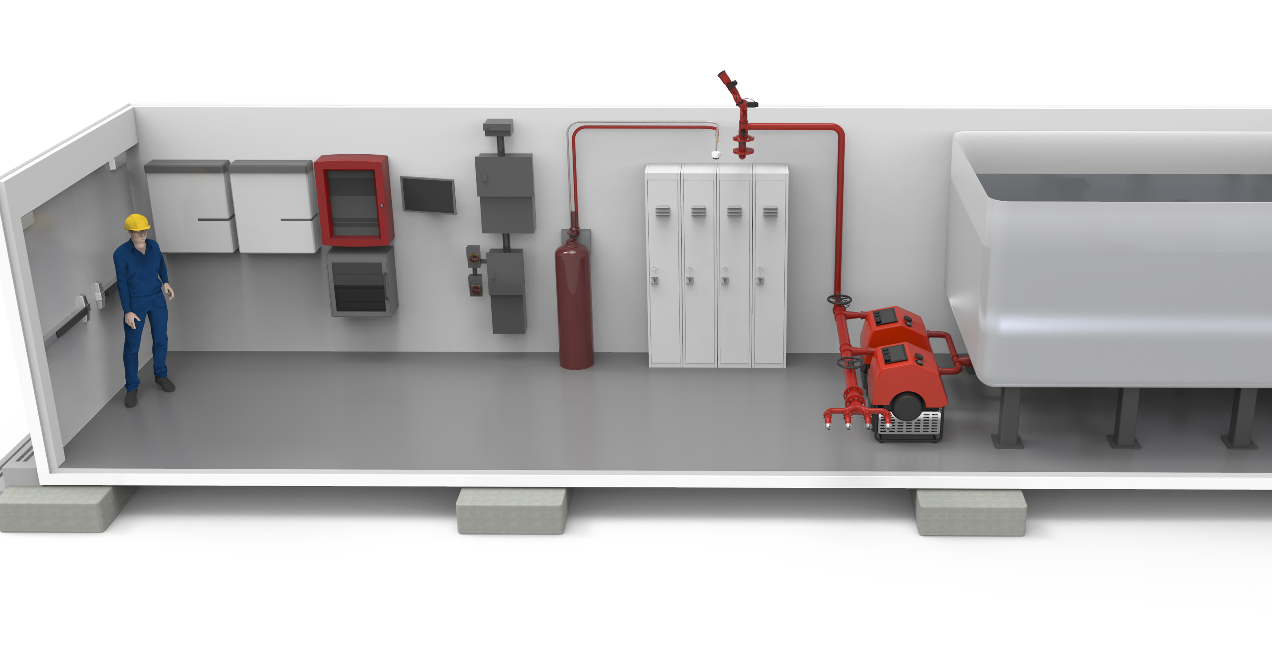
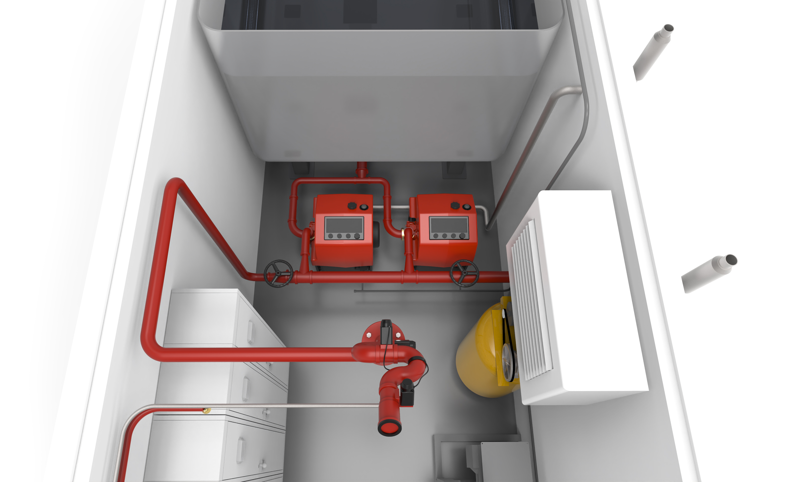
Remote Fire Station – Coming Mid 2022
Capable of providing active fire suppression with self primed pumps and remote control fire nozzles & monitors / alarm system with a dry run system that can work in freezing temperatures, drawing water from 1000 meters away (or more pending specs)
Notes:
X fire fighter as partner, Published in forest fire containment, operate our own certified industrial fire brigade
Multiple units can connect to provide fire suppression to a small village / base area (1km square)

Slide 13
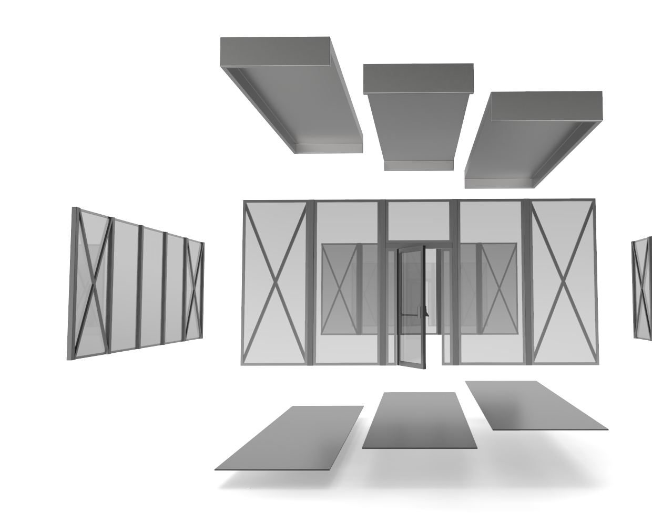
Proprietary structural wall & roof panel system for rapid deployment of large buildings with open spaces & tall ceilings Proprietary raised flooring system allowing heavy equipment service in heated buildings in the arctic Preinstalled electrical, mechanical components in roof & wall panels

Slide 14
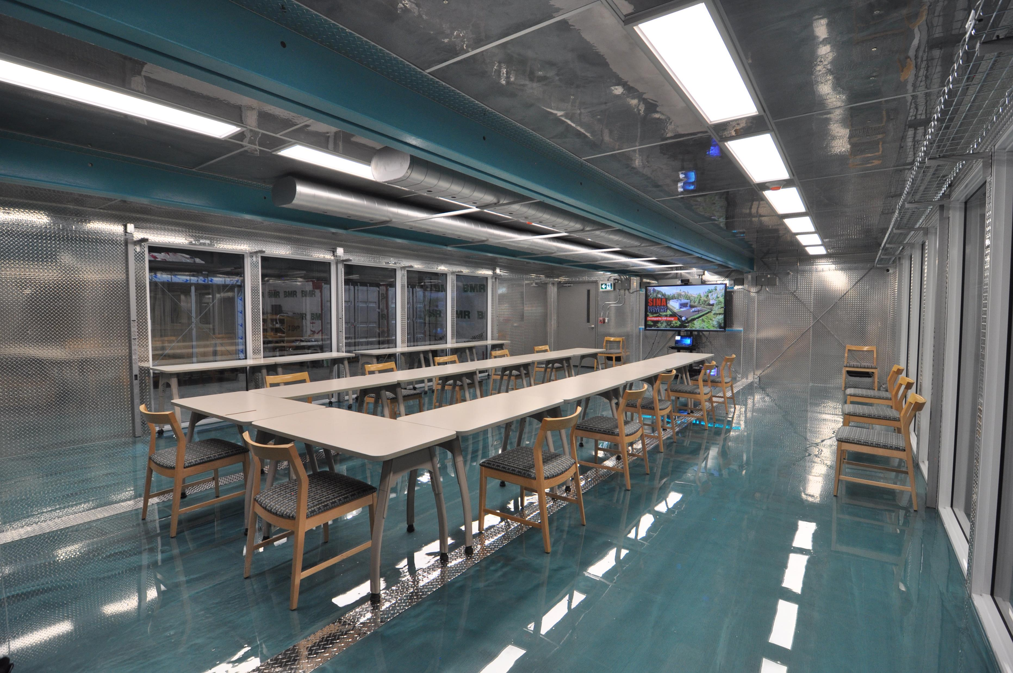
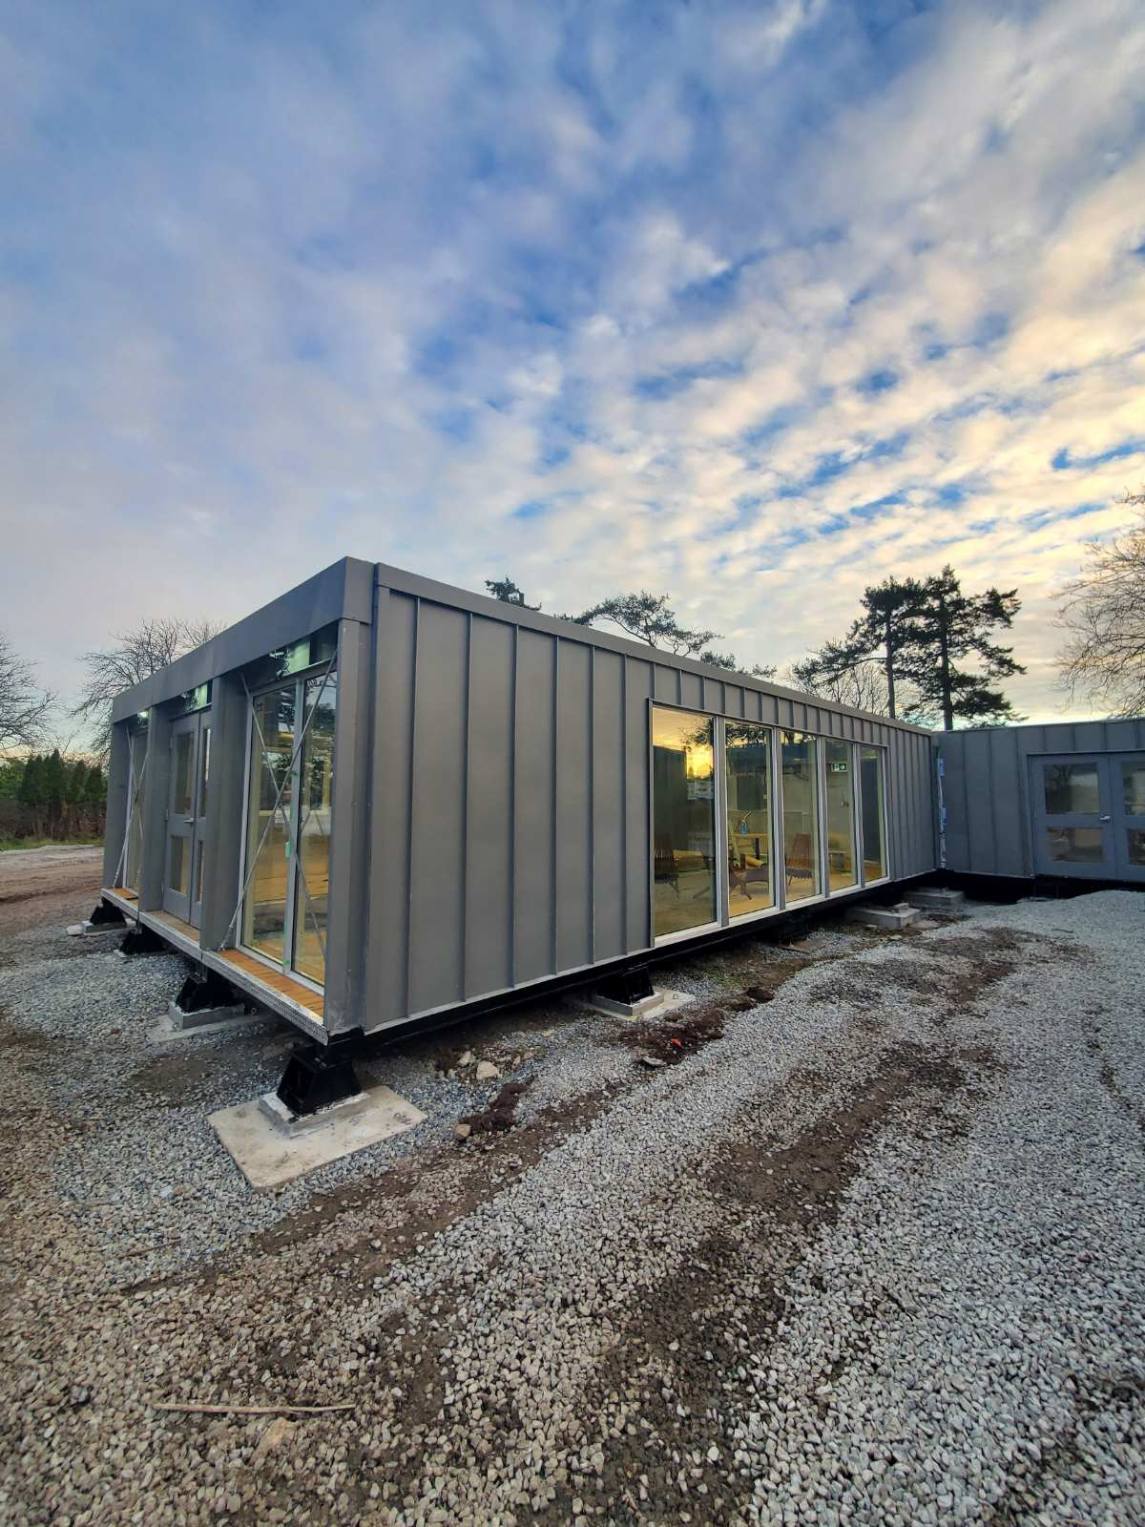
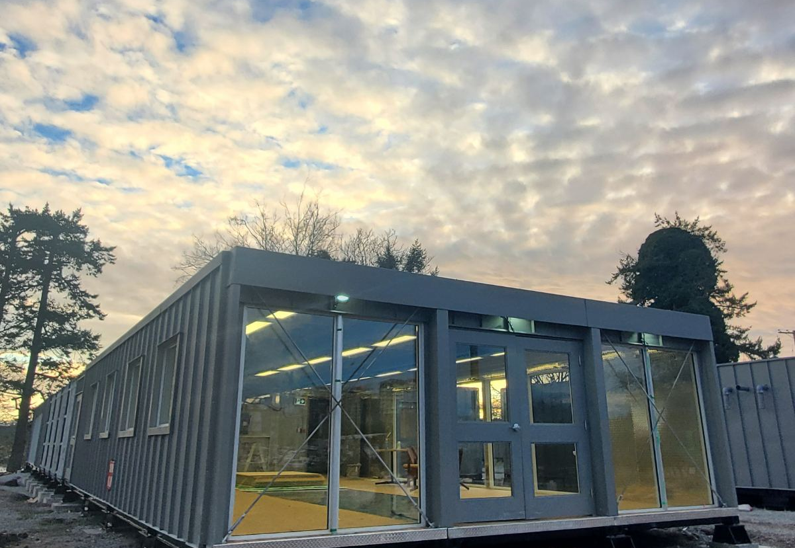
APPLICATIONS TO DATE
The iNexTT Facility for the Royal Canadian Navy (RCN) at Esquimalt, British Columbia.
"Establishing an unmatched twenty-first century National Security Innovation Base that effectively supports Department operations and sustains security and solvency." – 2018 national defense strategy
Notes:
Installed on ground variance of 20 inches
Winter deployment possible on jacks but we would want to hire a Geotech service and TOPOGRAPHIC SURVEY to assess capacity before deployment. If not possible, then we would do temporary deployment in the winter.
RE-deployable so initial deployment can be changed based on need – Professional support will be required. Idp can provide support.
Training on servicing of units will be provided.

Slide 15
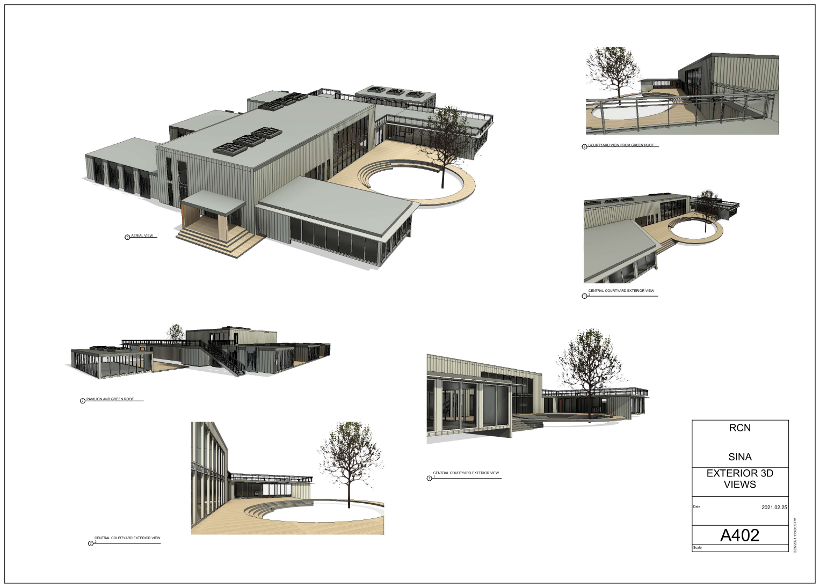
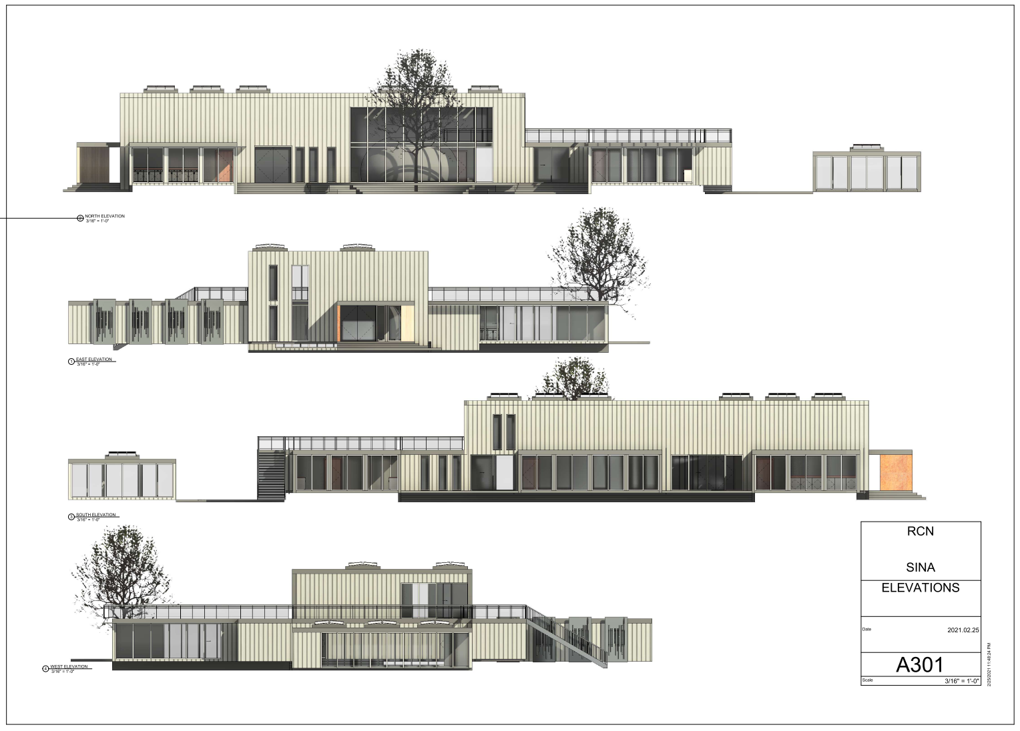
Current RCN iNexTT Project
Video of the RCN iNexTT Project
https://www.dropbox.com/s/bm3ion3tg6mgnzc/iNexTT%20Campus%20Video%20-%20RCN%20Internall.mp4?dl=0
Notes:
To add Video of the RCN Project (IMAX Center)

Slide 16
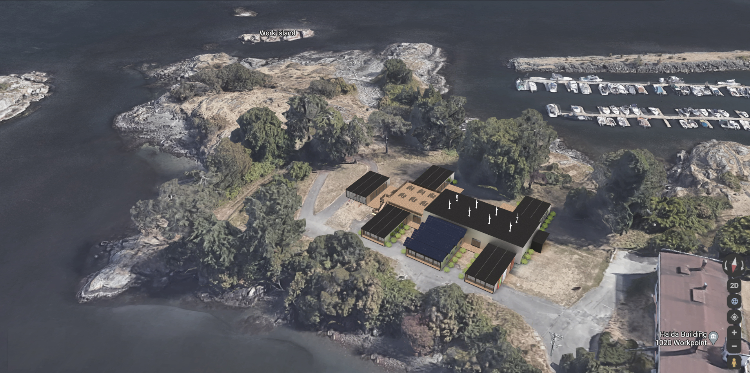

Slide 17
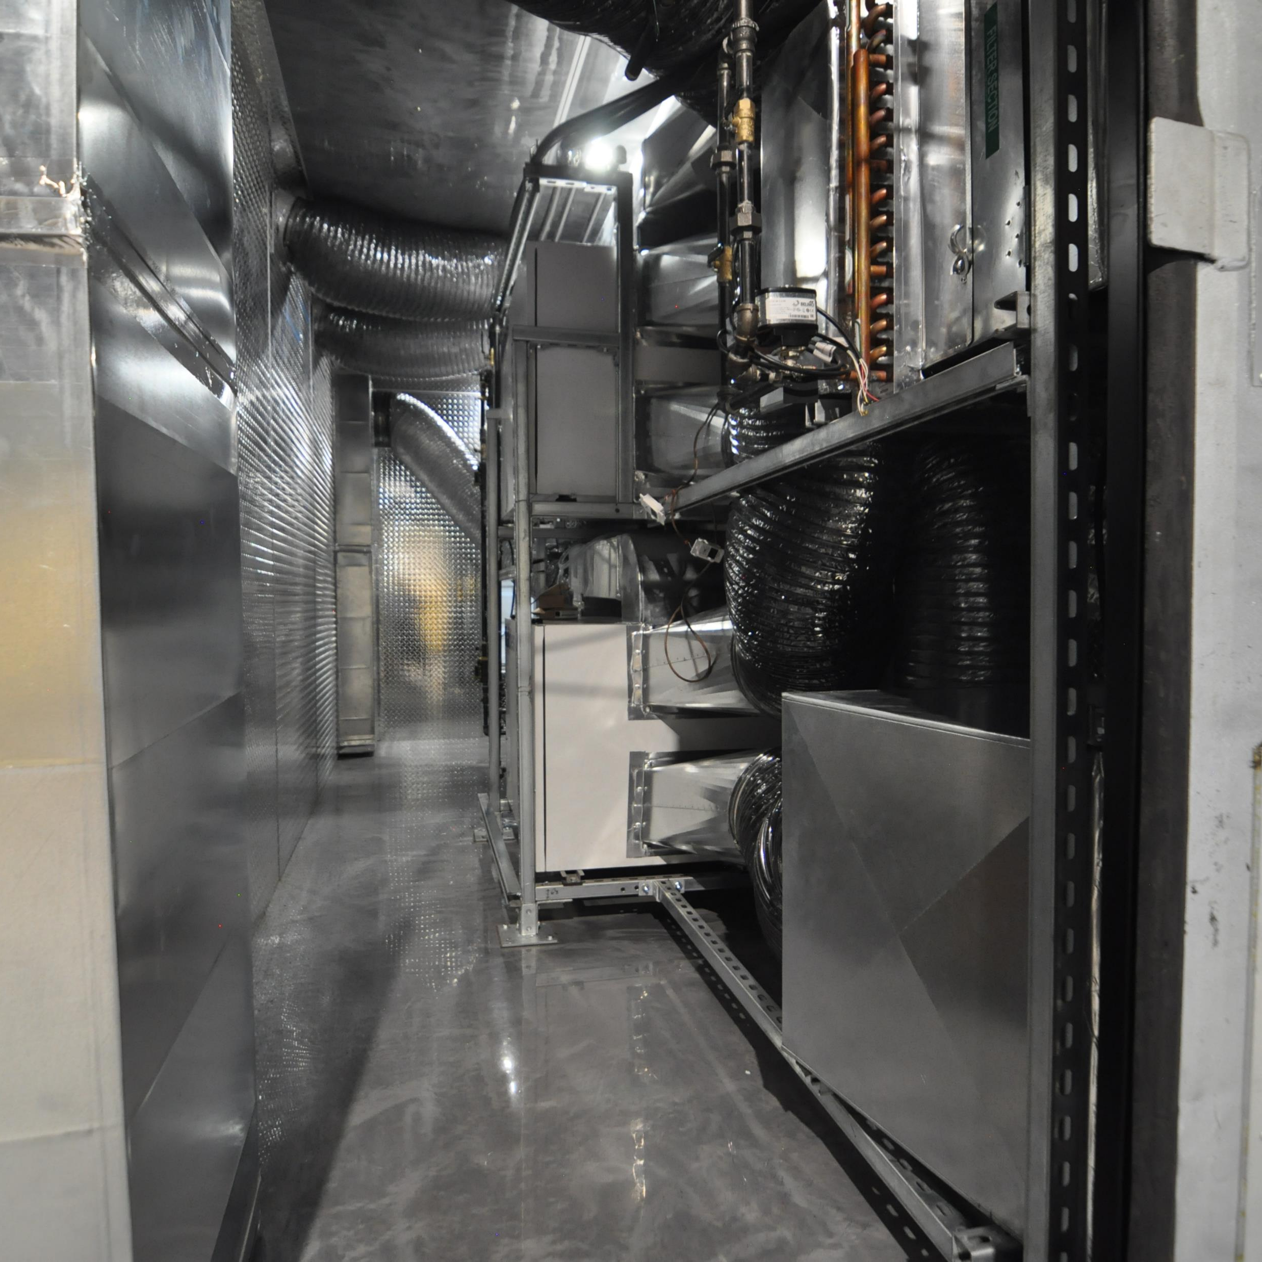
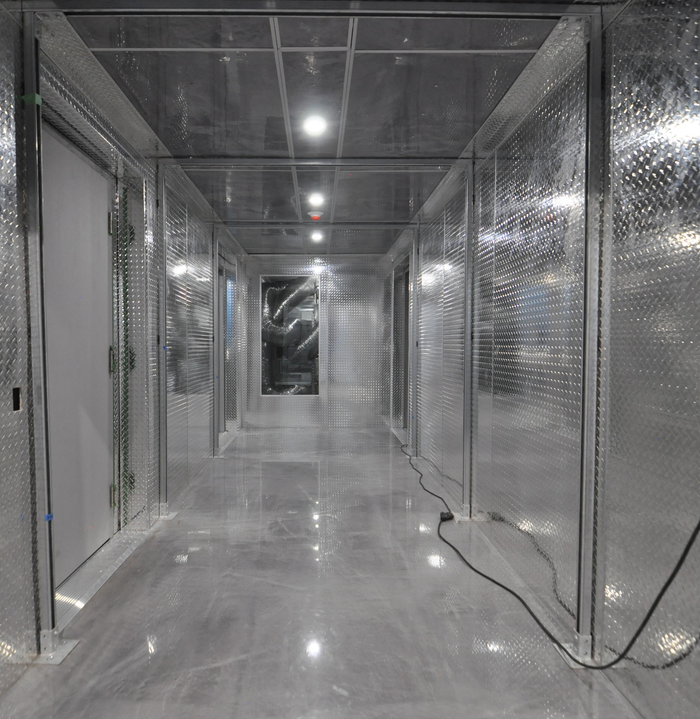
Royal Canadian Navy Micro-base – Videos & Pictures Of Actual Building Interior
https://vimeo.com/showcase/8798601
Password: inextt

Slide 18
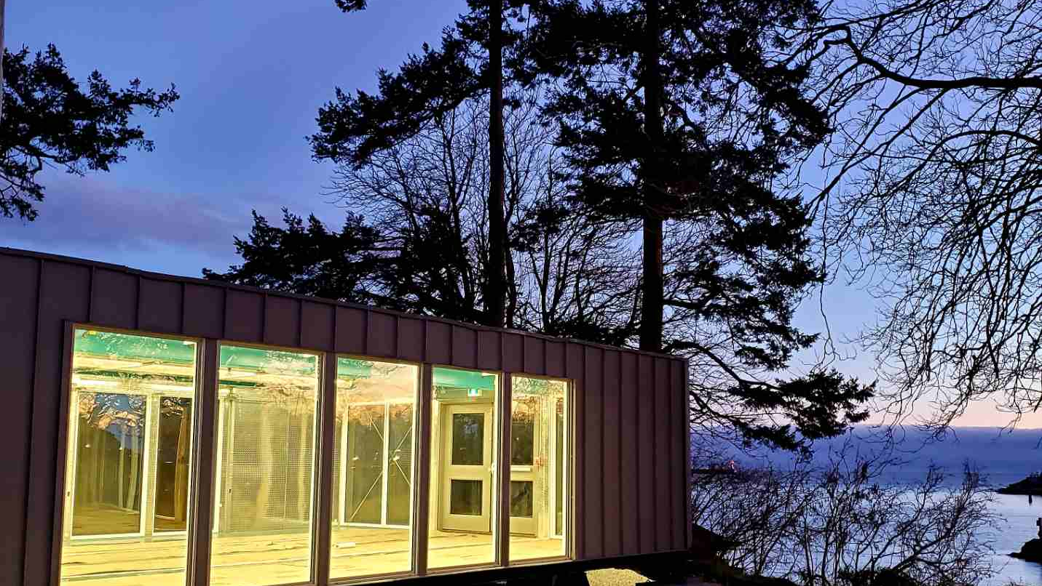
JOIN US FOR A DISCUSSION!

